Slide 1
Course Layout
High School Lawnmower Course

Slide 2
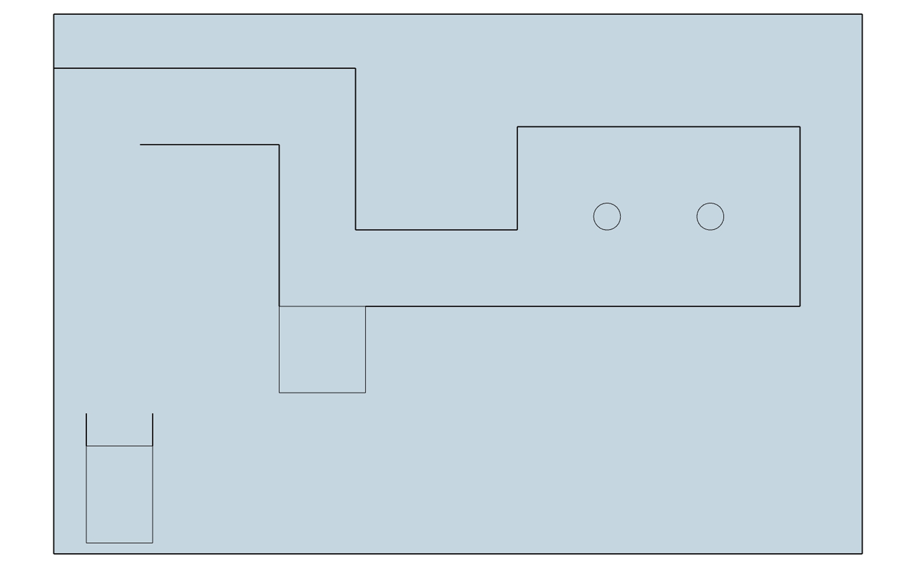
High School Course – Overhead View

Slide 3
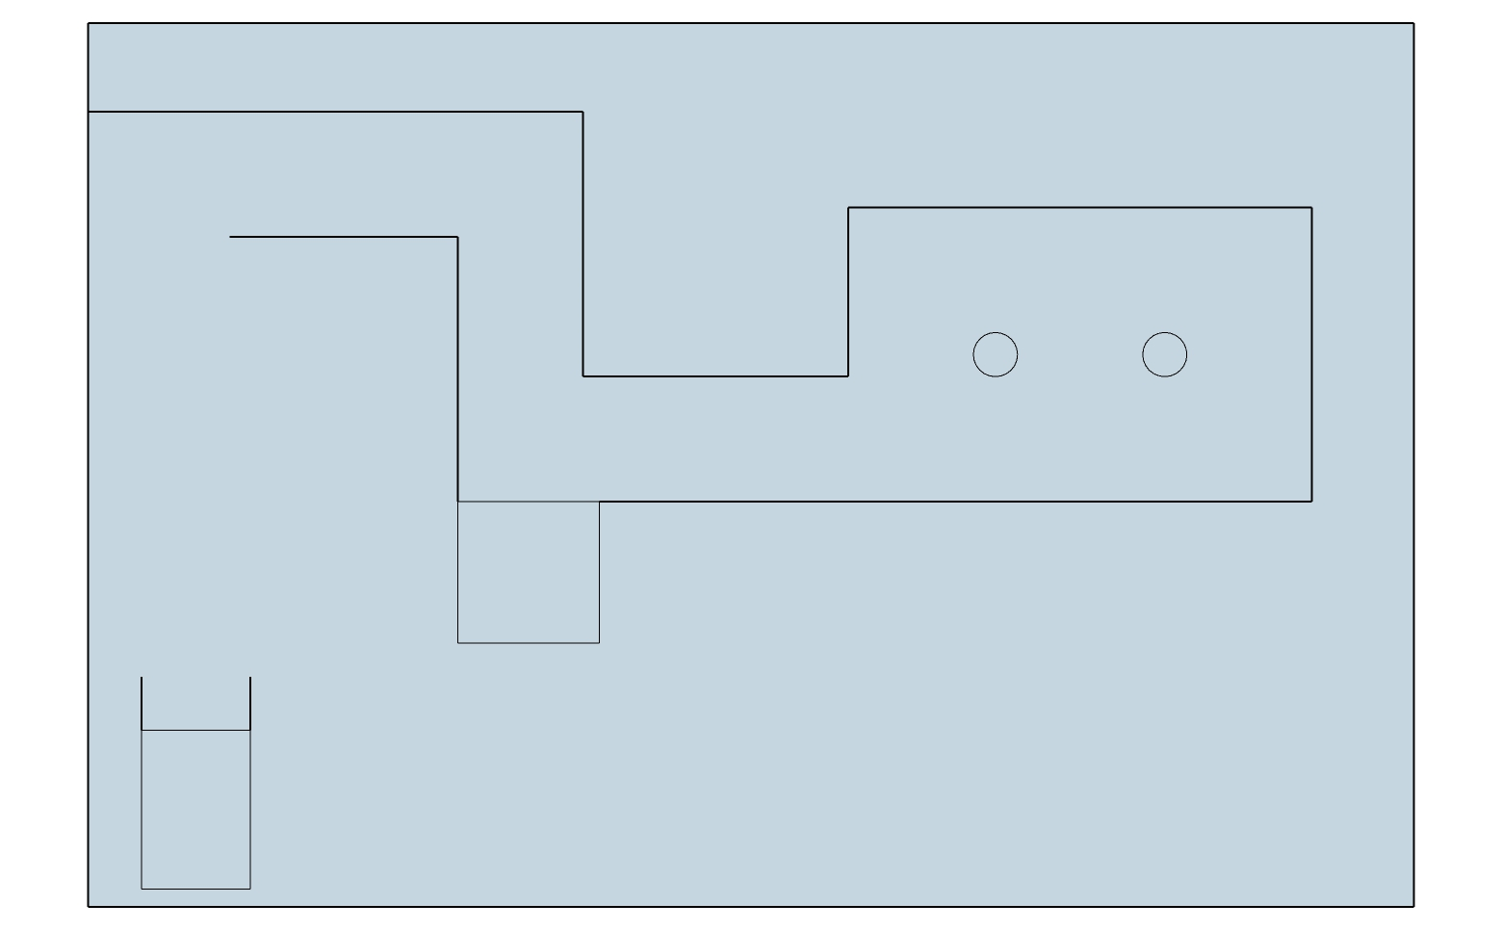

Slide 4
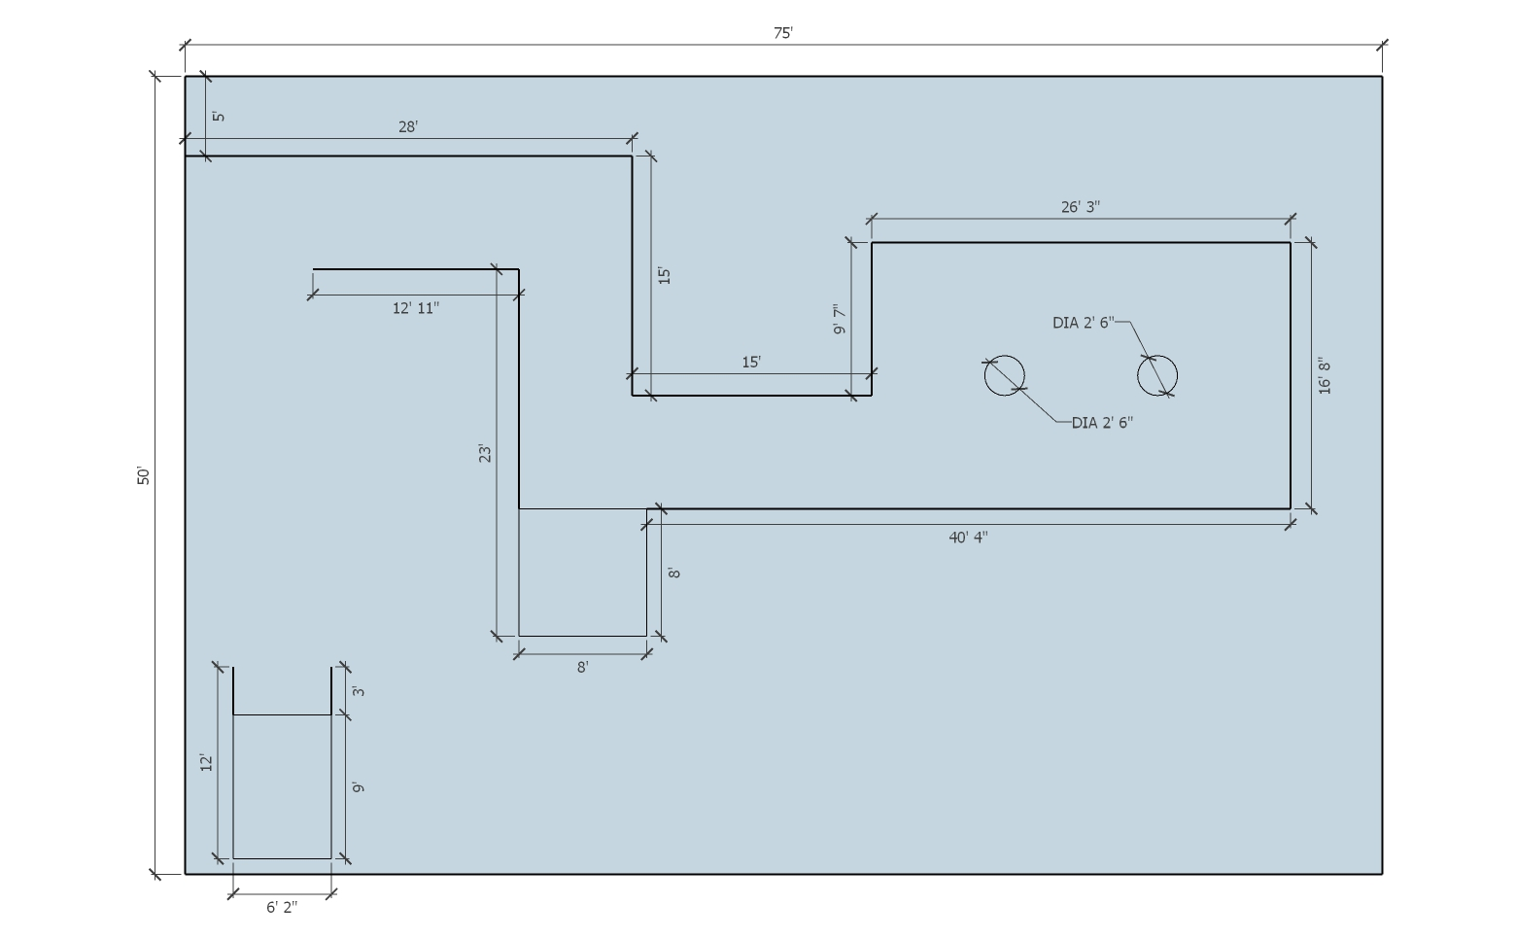

Slide 5
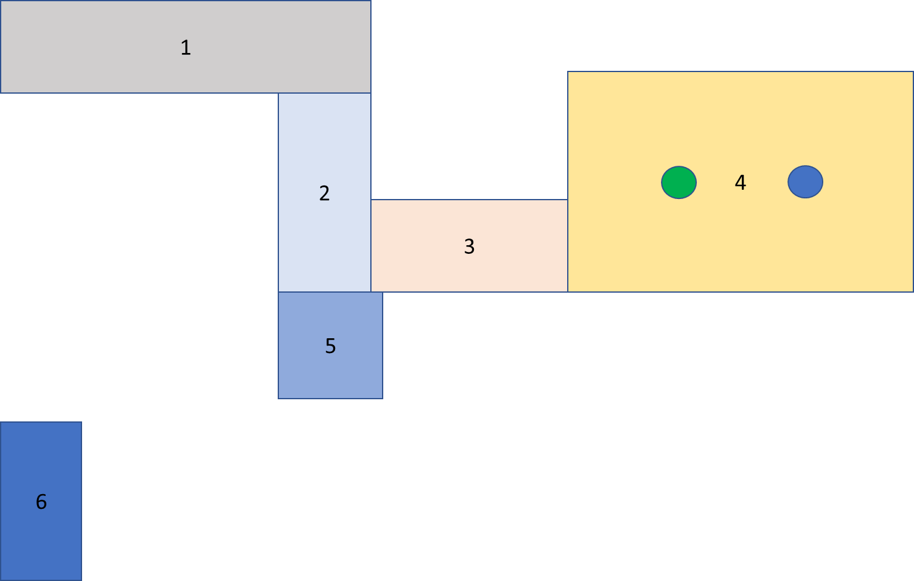
Break it up into blocks (6 total)

Slide 6
Begin by laying out the 1st block

Slide 7
28’
1
7’ 1”
Begin by laying out the 1st Block. It measures 28 feet x 7 feet and 1 inch (85 inches)

Slide 8
2
15’
Then attach the 2nd block to the 1st.
It measures 15 feet x 85 inches
85”

Slide 9
Continue with the 3rd block by attaching it to
the 2nd block.
It also measures 15 feet x 85 inches.
15’
3
85”

Slide 10
26’ 3”
4
16’ 8”
The 4th block is the most complicated because of the addition of the “trees.”
It measures 26 feet 3 inches x 16 feet 8 inches and is explained in greater detail in the next slide.

Slide 11

The diameter of
each circle is 30”
85”
Width of end is
85” + 30” + 85” = 200”
Or 16’ 8”
85”
85”
85”
85”
Length of side is 85” + 30” + 85” + 30” + 85” = 315” or 26’ 3”

Slide 12
5
8’
8’
Block 5 represents the “mow” area of the HS course and measures
8 feet x 8 feet square.

Slide 13
6
Block 6 is for the shed which is the starting and ending point for the event. The shed
measures 12 feet x 6 feet 2 inches and contains a start/stop line 3 feet from the end.
The 6 feet 2 inch measurement comes from the width of the deck with the discharge
raised + 12 inches.

