Slide 1
How to Determine Width of Lawnmower Course Alley
High School and Middle School CDEs

Slide 2
Determine Alley Width
Based on mower dimensions
Instructions can be found in the CDE guidelines (HS & MS)
HS alley width = 7’ 1” (85”) based on Exmark 60” mower dimensions
MS alley width = 6’ 2” (74”) based on Poulan Pro 42” mower dimensions

Slide 3
MS Mower Measurement Locations

Slide 4
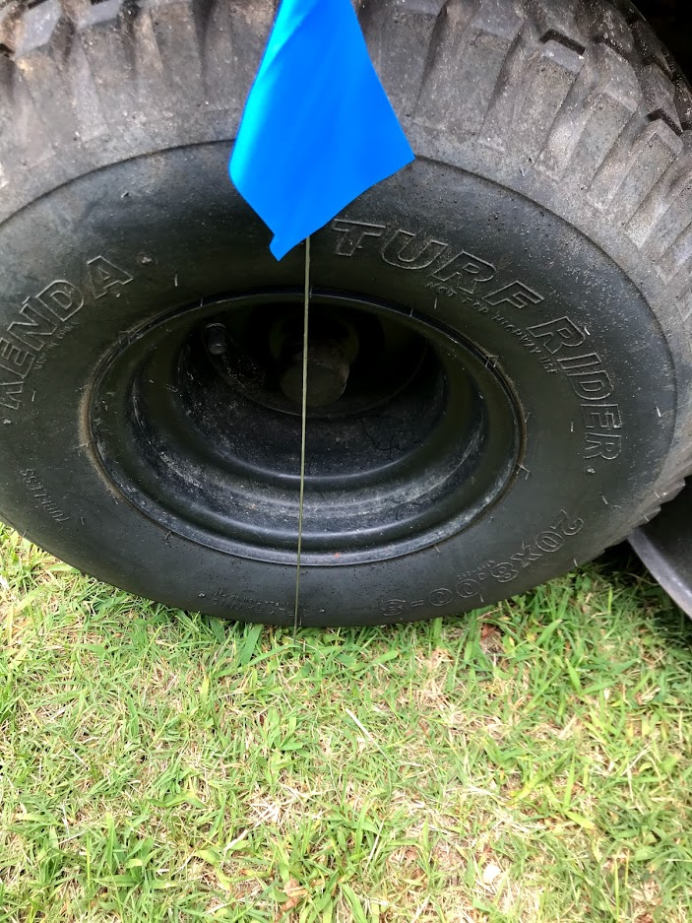
Diagonal Measurements – MS Outside Center of rear tire to inside center of front tire plus 18” = 74”

Slide 5
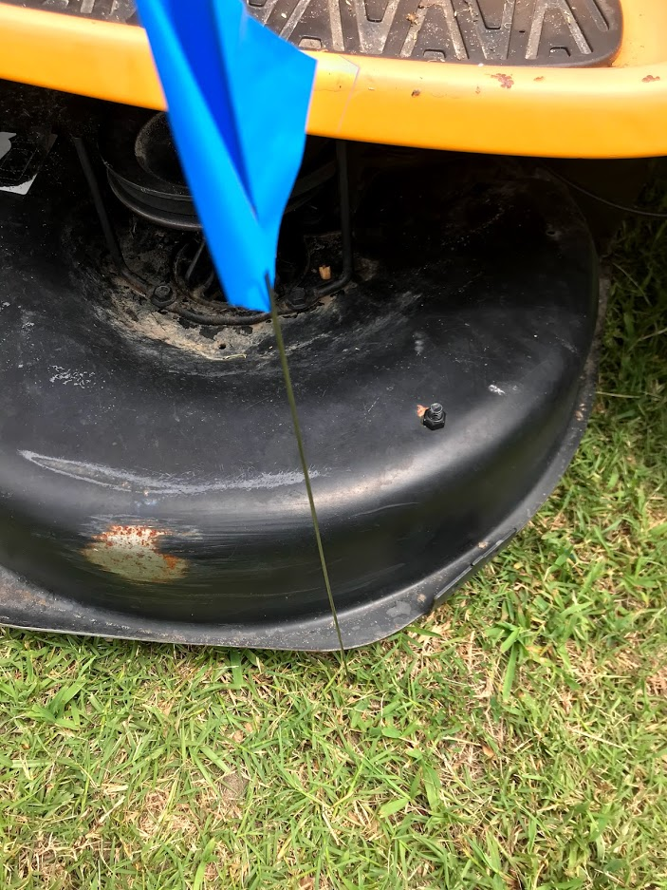
Width Measurements – MS Mower deck width plus discharge chute plus 18” = 68”

Slide 6
Middle School Alley Width
Diagonal width = 74” (includes the + 18”)
Discharge chute width = 68” (includes the + 18”)
We use the larger of the two measurements, so the MS course will be built using the 74” alley width

Slide 7
HS Mower Measurement Locations

Slide 8
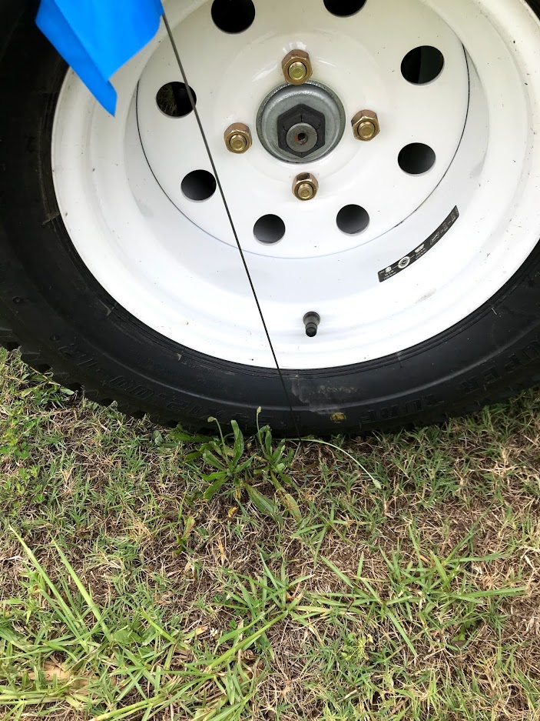
Diagonal Measurements – HS Outside Center of rear tire to inside center of front tire plus 12” = 79”

Slide 9
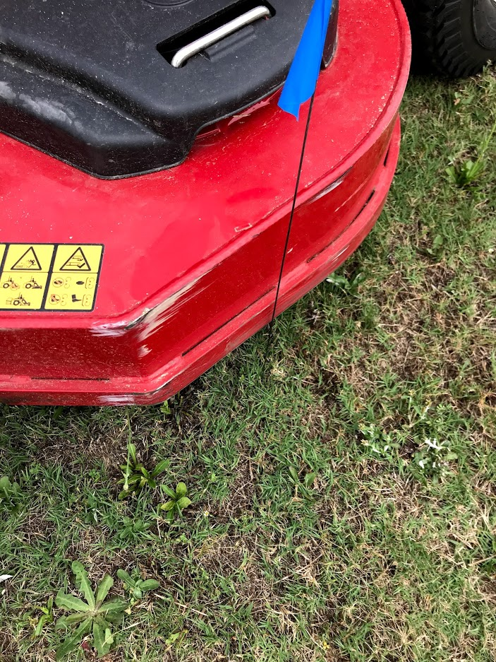
Width Measurements – HS Mower deck width plus discharge chute plus 12” = 85”

Slide 10
High School Alley Width
Diagonal width = 79” (includes the + 12”)
Discharge chute width = 85” (includes the + 12”)
We use the larger of the two measurements, so the HS course will be built using the 85” alley width

