Slide 1
Wooden Animal Banks
The inspiration for these plans come from Donald Dalton- Young Farmer Teacher at Thomas County Central.
Dennis Kendrick Young Farmer Teacher at Turner County also contributed to the creation of these plans as well!
Thanks a million!

Slide 2
Wood Materials Needed
For the Pig:
1” x 12” Pine Shelving Board for the legs
2” x 4” Spruce Lumber for the body
Leg pattern
Body pattern
For the Goats, Cow, and Horse
1” x 12” Pine Shelving Board for the legs
2” x 6” Pine Lumber or (Spruce if you can find it) for the body
Leg pattern
Body pattern

Slide 3
Directions for the Pig Project

Slide 4
Trace #1
1. Trace leg pattern onto the 1” x 12” Pine Shelving Board with feet lined up on the bottom of the board. (NOTE: Make sure pattern is lined up with the grain of the wood to prevent the wood from splitting when cutting it with Band Saw, Jig Saw or Scroll Saw.)
See my example’s

Slide 5
Trace #2
2. Trace body pattern onto the 2”x 4” Spruce Lumber.
NOTE: Line up and trace the leg pattern onto the 2”x 4” so you will know how far to cut out the interior of the bank! You don’t want to cut beyond the shoulder for the interior of the bank!!!
You need to allow no smaller than and 1/8” cut for the coin slot at the top center of the 2”x 4”.

Slide 6
Cut
3. Cut out both leg and body designs. Band Saw, Jigsaw, or Scroll Saw works well.
On the body portion, cut the interior out set to your desire BUT NOT PAST THE SHOULDERS!!!!
A good rule of thumb is to allow a 3/8” distance from the sides to the center all the way around (maximum). This will help prevent breakage as well.

Slide 7
Pre-glue
4. After cutting out desired pieces, line all three pieces up and sand to smooth any rough edges during the cutting process if needed.

Slide 8
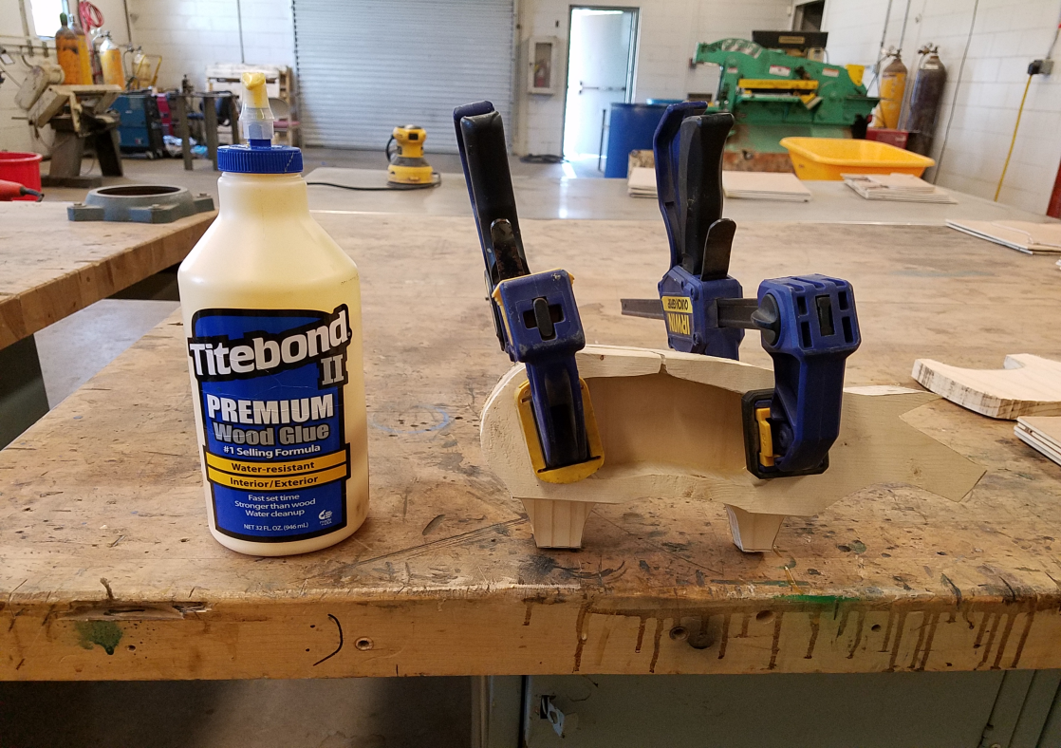
Gluing (phase #1)
5. Glue the legs onto body using yellow wood glue.
Note: Titebond II works well. The water-resistant brand
Line up legs and body
Clamp together
Also glue the wood
legs as to prevent
cupping!(See Example)

Slide 9
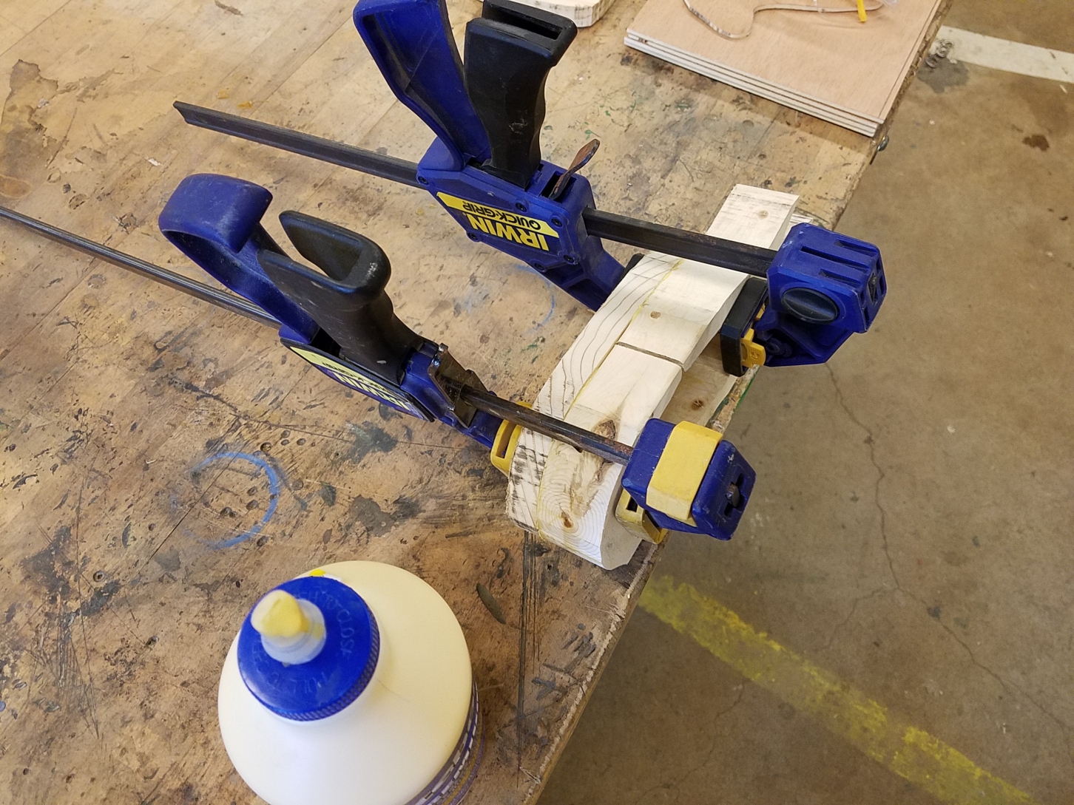
Gluing (phase #1) cont.

Slide 10
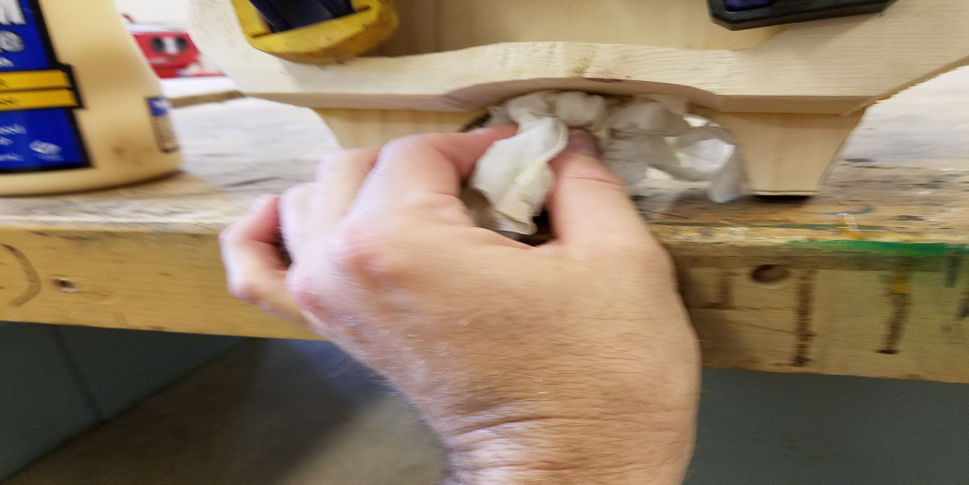
Gluing (phase #1) final.
6. Wipe up any glue with a damp paper towel: especially, on the underside where it will be difficult to sand later.
After wiping up any
excess glue, let the
project set overnight
or for at least 1 hour!!!

Slide 11
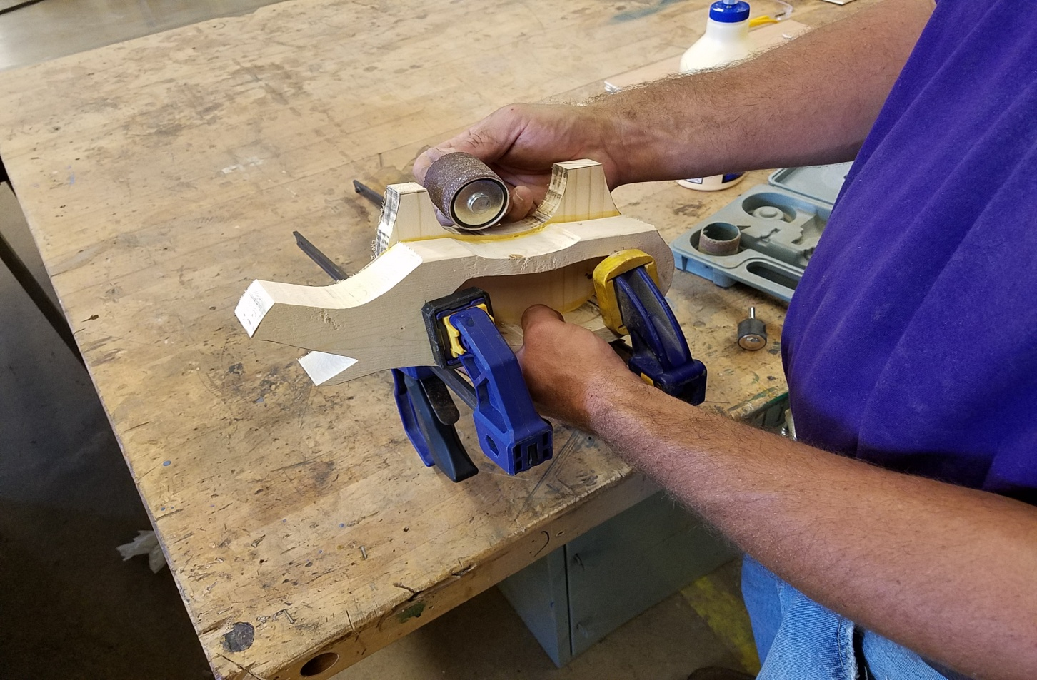
The Next Day-Drum Sand (Optional)
The next day, you may want use a drum sander bit to level/smooth out the underside of the belly.

Slide 12
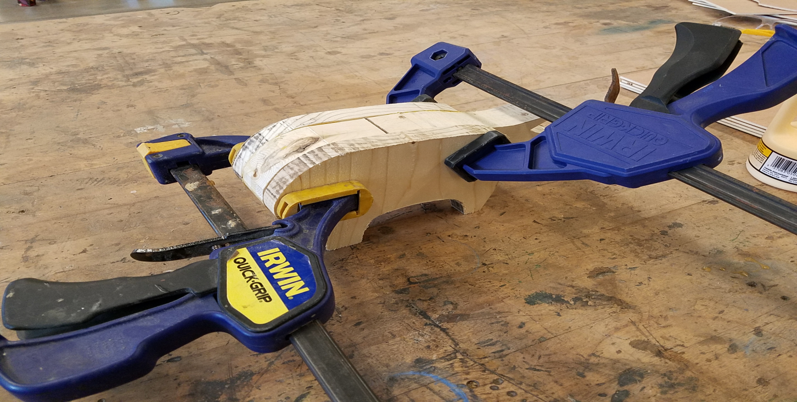
Gluing (Phase #2)
7. Glue the last set of legs onto the other side of the body and level on a flat surface!!
VERY IMPORTANT STEP here because you want to make sure the bank will be level!!!
NOTE: Also glue the wood
legs as to prevent
cupping!(See Example)

Slide 13
The Next Day after Gluing (Phase # 2)-Drum Sand (Optional)
The next day, you may want use a drum sander bit to level/smooth out the underside of the belly.

Slide 14
Drill Coin Opening
8. Drill Hole for coin opening.
2 options here that are up to you the teacher, either on the underside of the animal or on the rear end of the animal!!!
Totally up to you!!
A 1” Fostner bit works best or a 1” Spade bit works well. JUST GO SLOW!!!!

Slide 15
For the Plug
9. 2 options again here for this step.
1st option you can cut out a plug (if you have a Scroll Saw that is) using a 12 degree angle on the table adjustment.
The diameter of the plug will need to be a 1 -1/16” (see my example). Use a compass to draw out on scrap 1” x 12” Pine Shelving Board.
2nd option would probably be my best recommendation in which you would need to secure some corks and cut to fit!

Slide 16
Sanding, Painting, and Decorating
10. To finish out this project: sanding, sanding, sanding!!! To your specifications!
I would recommend a 80-60 grit sandpaper.
You can use an electric (handheld sander) or just have students sand by hand!
Paint to your desire
NOTE: I would highly recommend tying this in with your livestock lesson incorporating animal breeds!!
Have students paint it to a breed of their desire!!
Also you can incorporate wire 12/14 gauge bare copper for pig tails, felt for animal ears, craft eyeballs for the eyes, etc.
Just let the artist come out !!

Slide 17
Horse, Goat, Cow Banks
Repeat steps 1-10 above but the patterns I have call for you to use a 2” x 6” Pine Lumber or (Spruce if you can find it) for the body!!
1” x 12” Pine Shelving Board will work fine for the legs!

Slide 18
Patterns
Feel free to copy your own patterns on the panel strips I have supplied to take home with you at the conclusion of the breakout session!!!
You can also trace my patterns on manila folders if all wood panels are gone. This will serve as a good pattern to use in your instruction!!
PLEASE, PLEASE, DON’T TAKE MY PATTERNS!
Thank You!!!

