Slide 1
Junior Nursery Landscape
South Region
Area CDE 2020

Slide 2
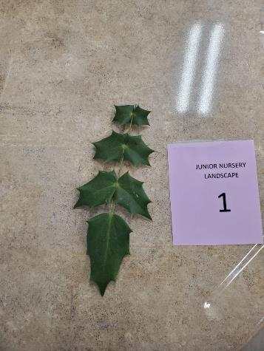
Mahonia, Leatherleaf / Mahonia bealei

Slide 3
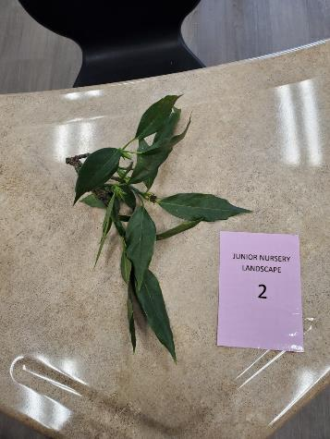
Aucuba, Japanese / Aucuba japonica cv.

Slide 4
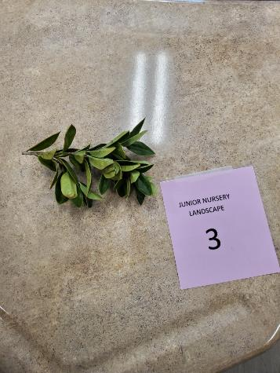
Holly, Carissa / Ilex cornuta ‘Carissa’

Slide 5
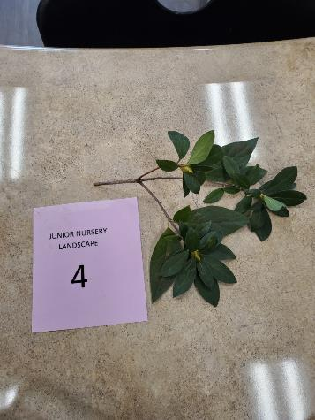
Azalea / Rhododendron hybrid

Slide 6
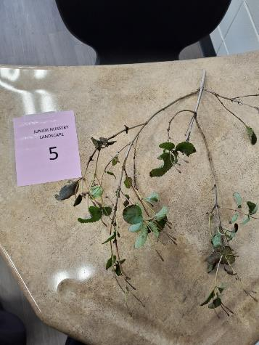
Lantana / Lantana camara

Slide 7
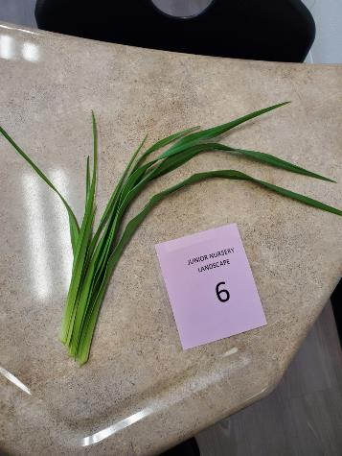
Daylily / Hemerocallis species cv.

Slide 8
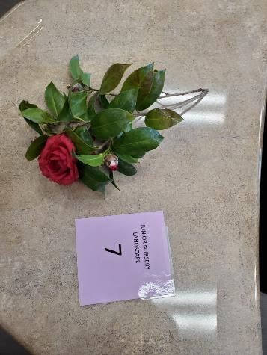
Camellia / Camellia japonica cv.

Slide 9
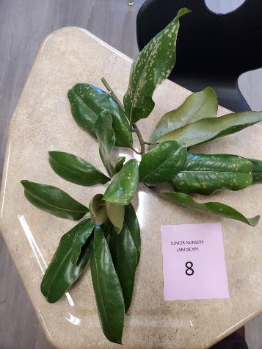
Magnolia, Southern / Magnolia grandiflora cv

Slide 10
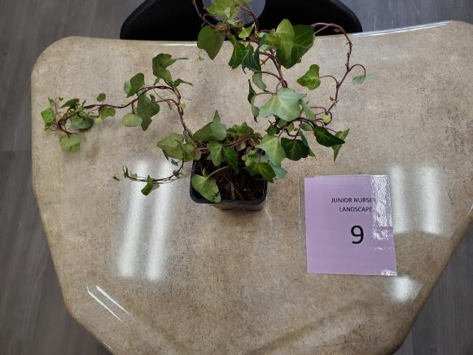
Ivy, English / Hedera helix

Slide 11
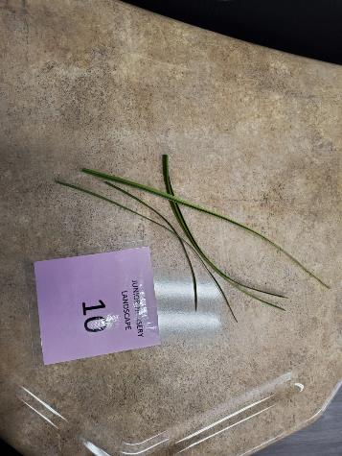
Liriope / Liriope muscari cv.s

Slide 12
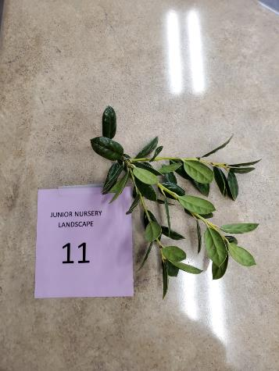
Holly, Dwarf Burford / Ilex cornuta ‘Burfordii’

Slide 13
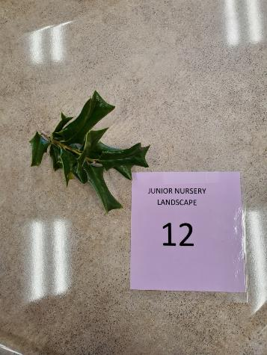
Holly, Chinese / Ilex cornuta

Slide 14
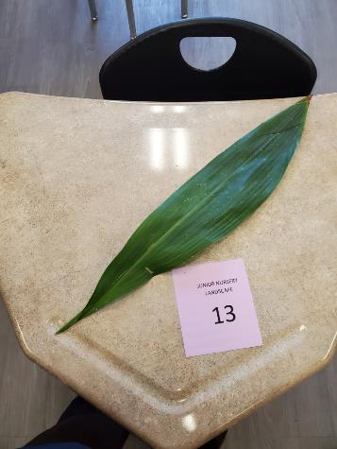
Cast Iron Plant / Aspidistra elatior

Slide 15
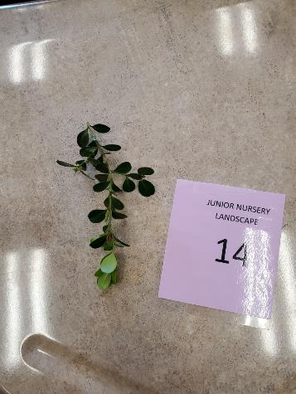
Boxwood / Buxus species

Slide 16
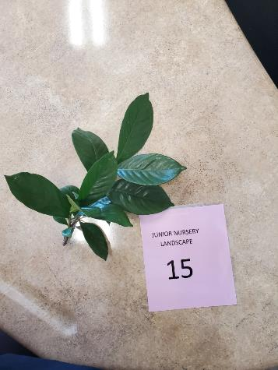
Gardenia, Cape Jasmine / Gardenia jasminoides

Slide 17
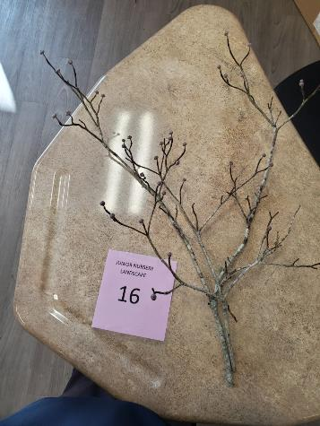
Dogwood, Flowering / Cornus florida

Slide 18
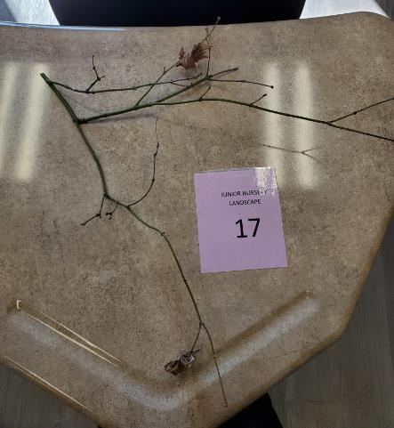
Maple, Japanese / Acer palmatum cv.

Slide 19
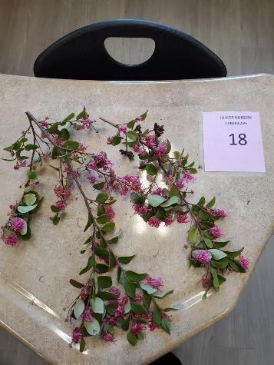
Loropetalum / Loropetalum chinese

Slide 20
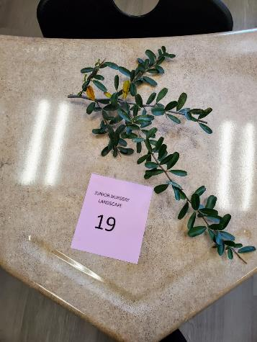
Pyracantha / Pyracantha coccinea

Slide 21
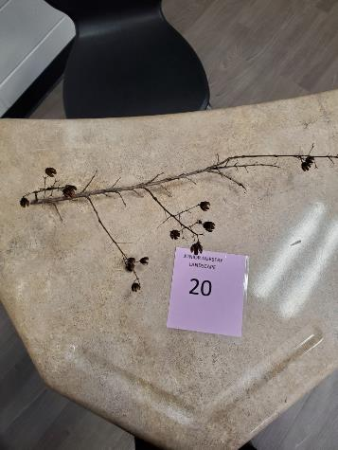
Crape Myrtle / Lagerstroemia indica cv.

Slide 22
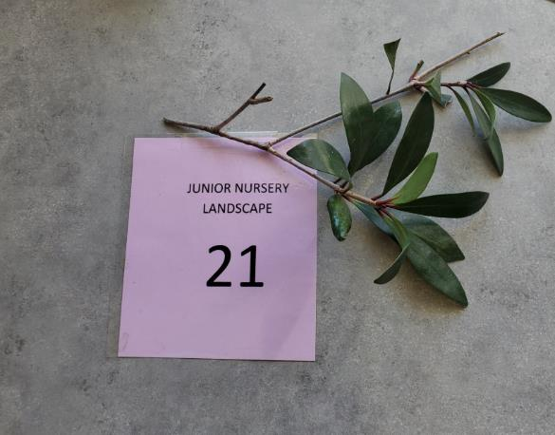
Cleyera, Japanese / Ternstroemia gymnanthera

Slide 23
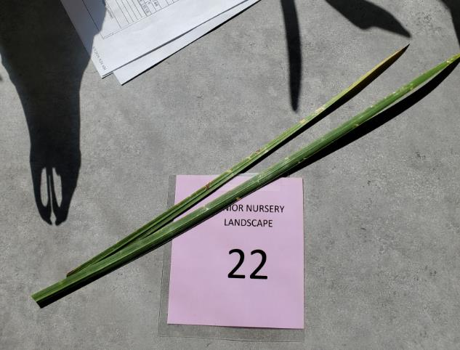
Fountain Grass / Pennisetum setaceum

Slide 24
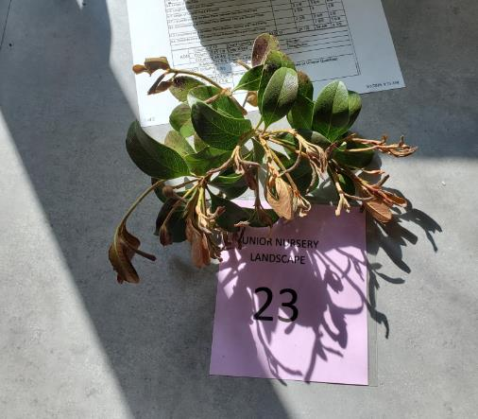
Hawthorn, Indian / Raphiolepis indicum

Slide 25
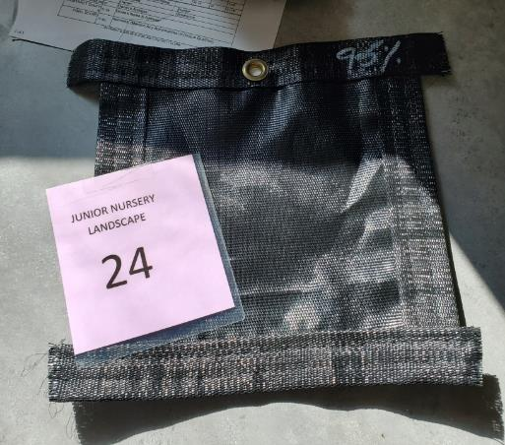
Shade fabric (Shade cloth)

Slide 26
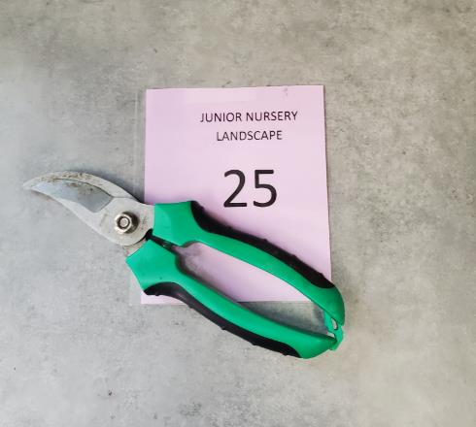
Bypass pruner

