Slide 1
2018 State Floral Design CDE
Junior ID

Slide 2
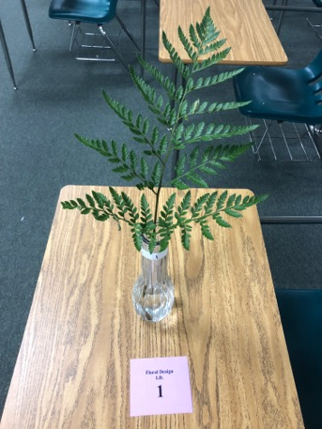
Leather leaf Fern / Rumohra adiantiformis

Slide 3
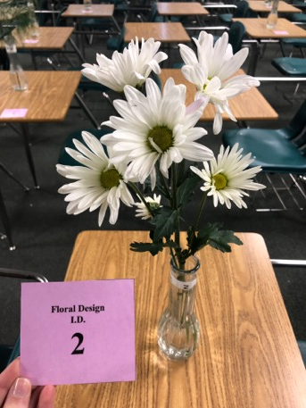
Chrysanthemum / Chrysanthemum morifolium

Slide 4
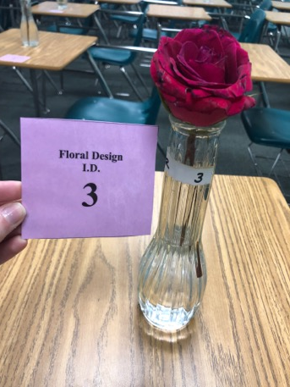
Rose / Rosa hybrida

Slide 5
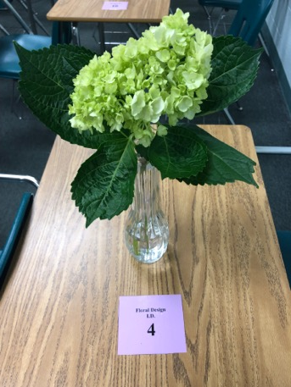
Hydrangea/Hydrangeaceae

Slide 6
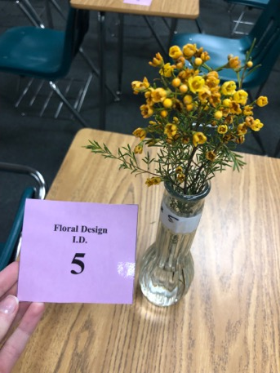
Wax Flower/Chamelaucieae

Slide 7
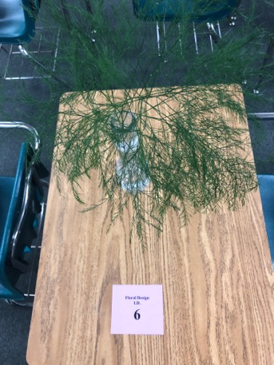
Tree Fern / Asparagus virgatus

Slide 8
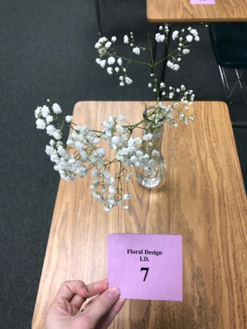
Baby’s Breath / Gypsophila paniculata

Slide 9
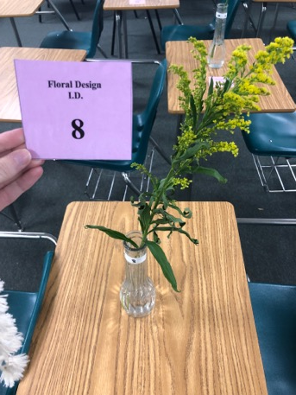
Solidago (Goldenrod) / Solidago

Slide 10
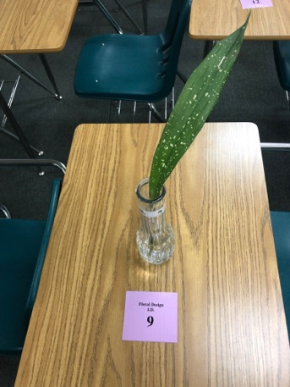
Aspidistra/ Aspidistra elatior

Slide 11
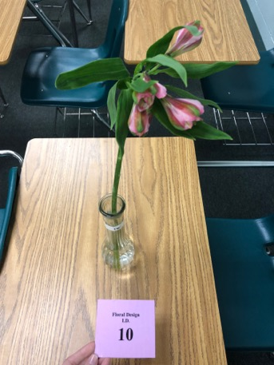
Alstroemeria / Alstroemeria sp.

Slide 12
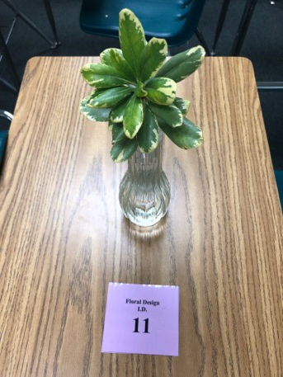
Pittosporum / Pittosporum tobira

Slide 13
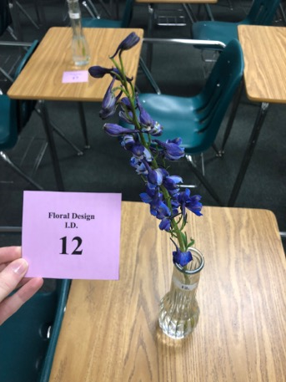
Delphinium / Delphinium elatum

Slide 14
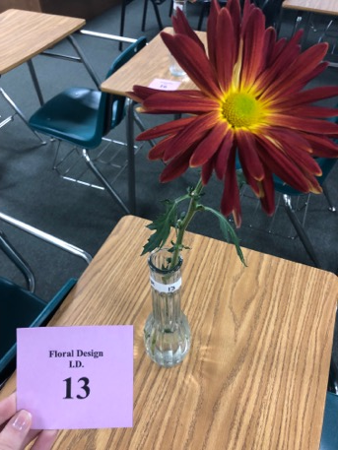
Spider or Fuji Mum/Chrysanthemum sp.

Slide 15
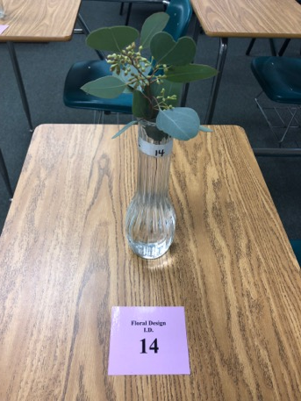
Eucalyptus / Eucalyptus sp.

Slide 16
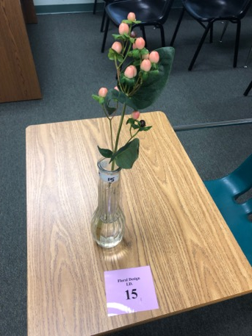
Hypericum Berry/Hypericaceae

Slide 17
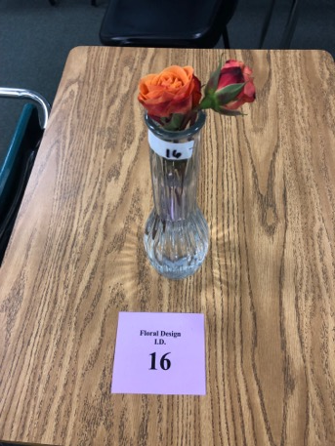
Spray Roses/Rosa sp.

Slide 18
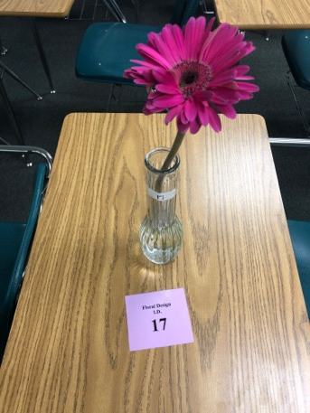
Gerbera Daisy / Gerbera jamesonii

Slide 19
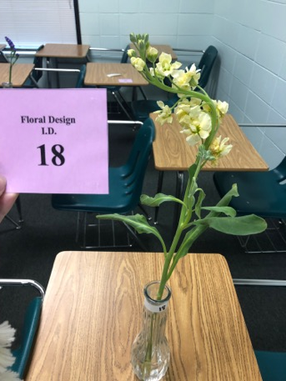
Stock / Matthiola incana

Slide 20
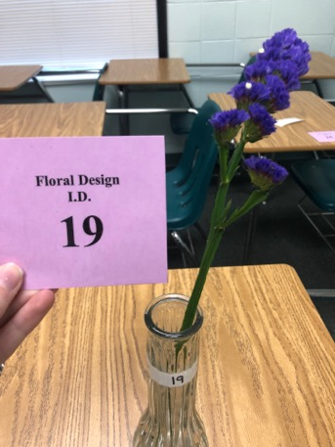
Statice / Limonium latifolium

Slide 21
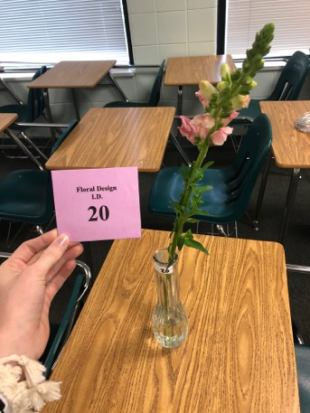
Snapdragon / Antirrhinum major

Slide 22
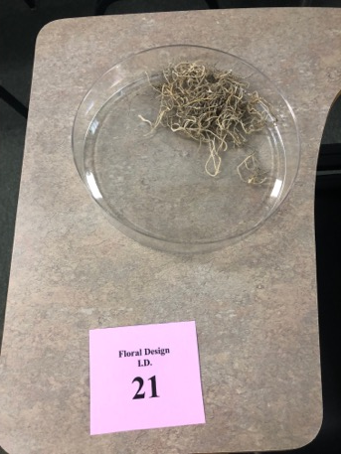
Spanish moss

Slide 23
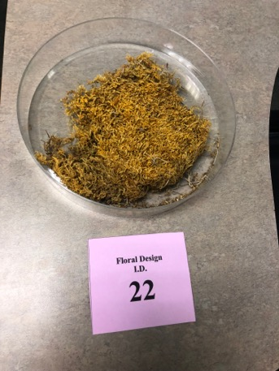
Sheet moss

Slide 24
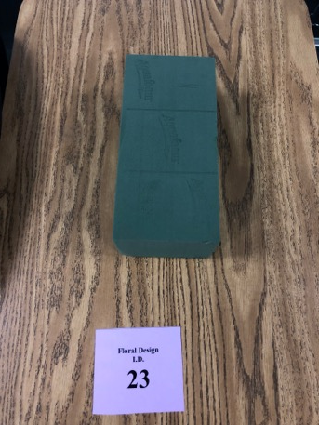
Floral foam

Slide 25
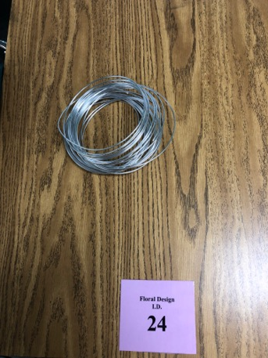
Decorative wire

Slide 26
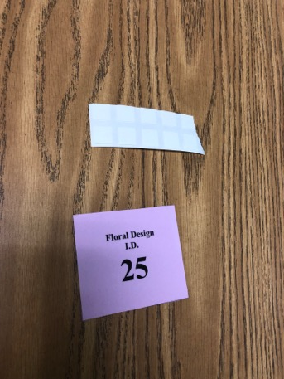
Floral Adhesive

