Slide 1
Course Layout
Middle School Lawnmower Course

Slide 2
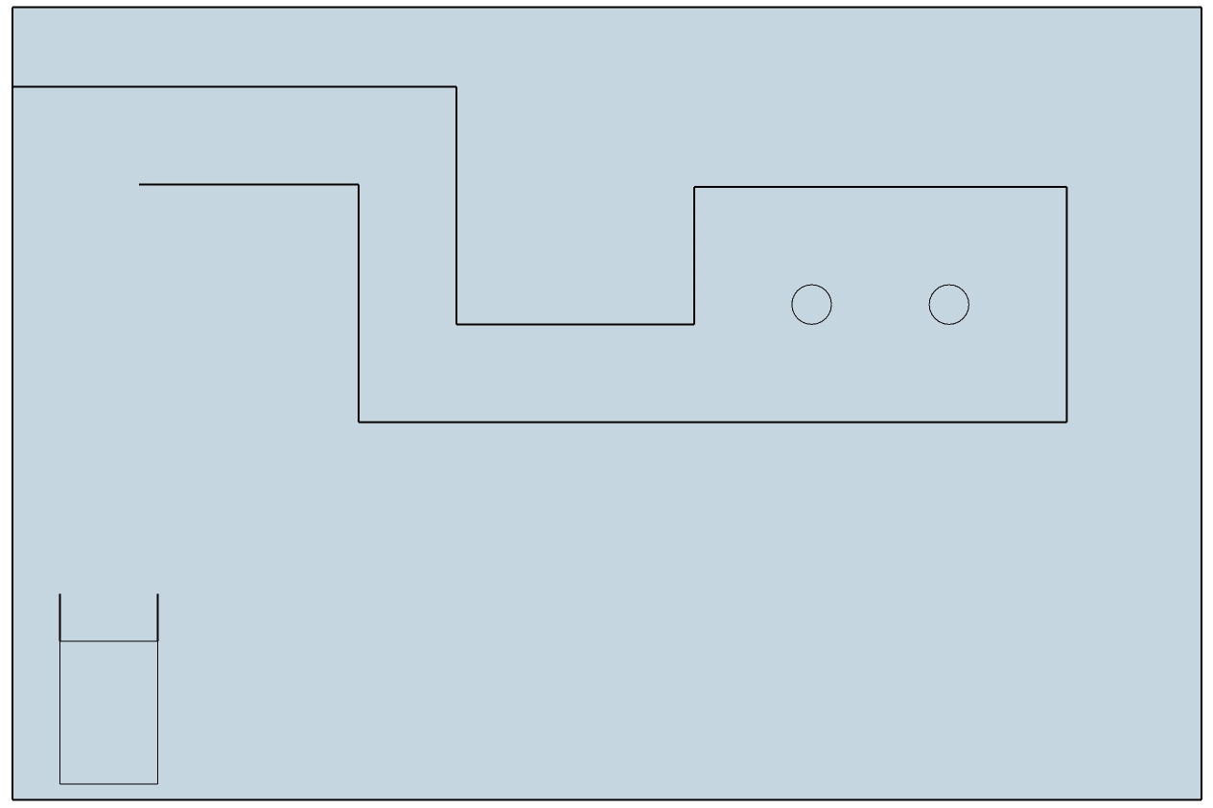
Middle School Course – Overhead View

Slide 3
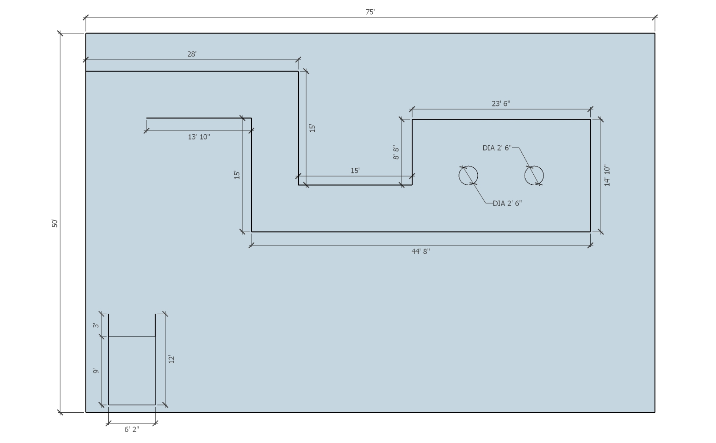

Slide 4

1
4
2
3
Break the course up into 5 separate blocks. Lay it out block by block until complete.
5

Slide 5
28’
1
6’ 2”
Or
74”
Begin by laying out the 1st Block. It measures 28 feet x 6 feet and 2 inches (74 inches)

Slide 6
2
15’
Then attach the 2nd block to the 1st.
It measures 15 feet x 74 inches
74”

Slide 7
Continue with the 3rd block by attaching it to
the 2nd block.
It also measures 15 feet x 74 inches.
15’
3
74”

Slide 8
23’ 6”
4
14’ 10”
The 4th block is the most complicated because of the addition of the “trees.”
It measures 23 feet 6 inches x 14 feet 10 inches and is explained in greater detail in the next slide.

Slide 9
The diameter of
each circle is 30”
74”
Width of end is
74” + 30” + 74” = 178”
Or 14’ 10”
74”
74”
74”
74”
Length of side is 74” + 30” + 74” + 30” + 74” = 282” or 23’ 6”

Slide 10
5
Block 5 is for the shed which is the starting and ending point for the event. The shed
measures 12 feet x 6 feet 2 inches and contains a start/stop line 3 feet from the end.

