Slide 1

Nursery/Landscape Plant Id tips sorted By Category
This is a free resource provided by Georgia Agricultural Education
Original creator: Melissa Riley, Central Region Horticulture Teacher

Slide 2
Ground covers & vines

Slide 3
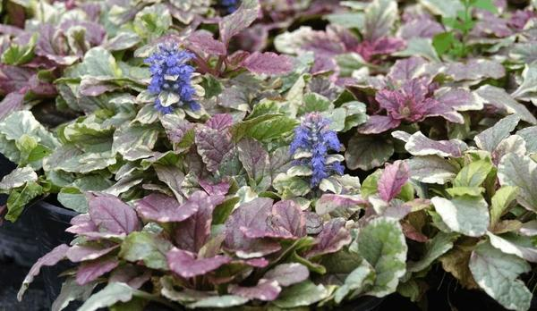
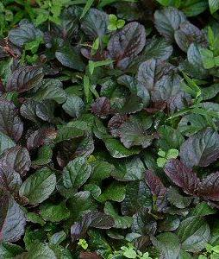
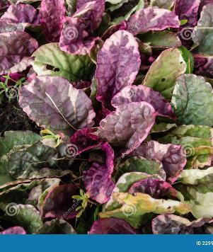
Ajuga (carpet bugle)
Ground cover, less than 1 foot tall
Leaves look like false dandelion
Tight dense growth-herbaceous
Flowers usually blue-purple
Leaves purple to bronze

Slide 4
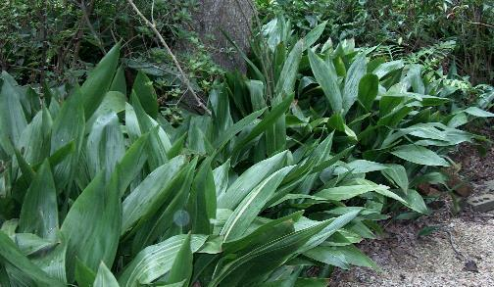
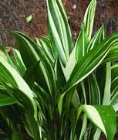
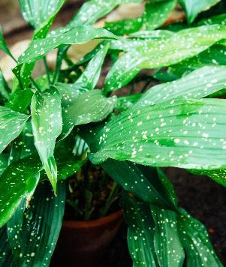
Cast iron plant
Evergreen shrub or clump
Parallel venation
Each leaf is on a single stem
Large, glossy leaves that can be solid green, speckled or variegated

Slide 5
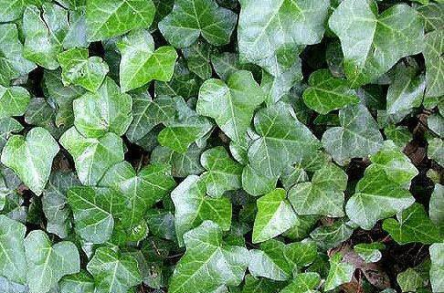
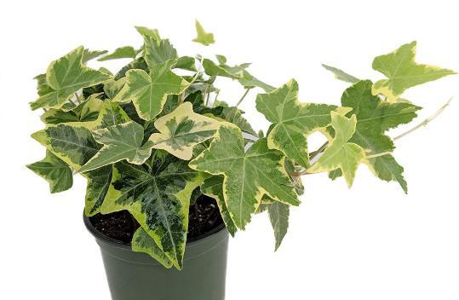
English ivy
Evergreen
Vine or Trailing Groundcover
Woody stems on older growth
Three-lobed/starlike shaped leaf
Can be variegated

Slide 6
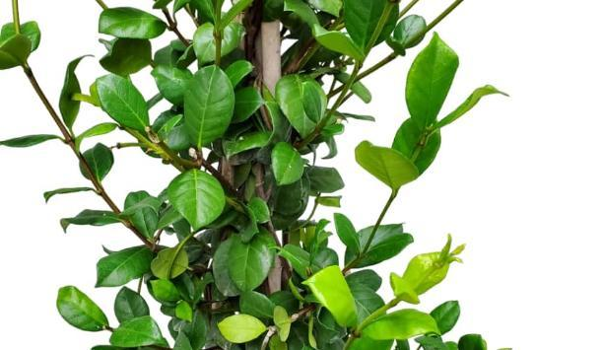
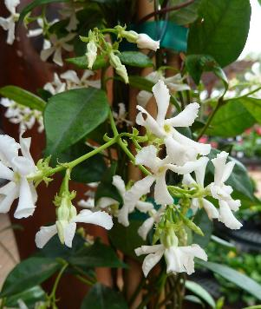
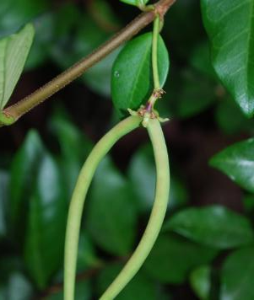
Confederate jasmine
Evergreen vine
Star flowers
Leaves opposite and have a thick, fleshy texture
Woody stems, dark brown to reddish in color
Produce long, narrow seed pods

Slide 7
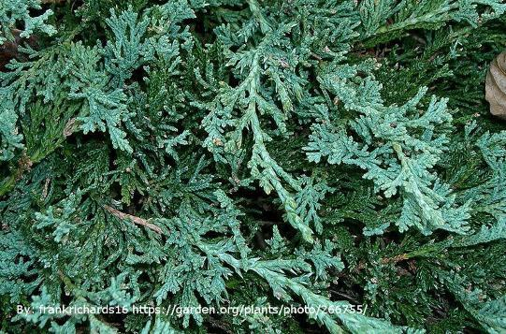
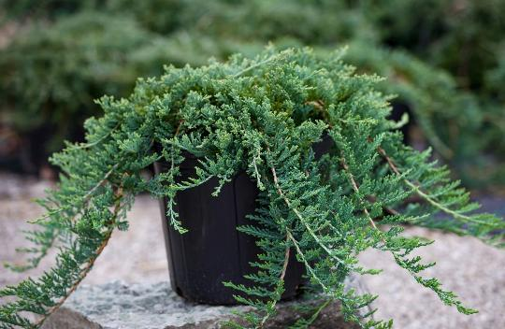
Blue rug juniper
Evergreen groundcover
Soft needles, not spikey like shore
Fine, scale-like needles with a bluish-silver color that can turn purple in cold weather
Needles have an upright growth pattern, but the plant does not get over 1 foot tall

Slide 8
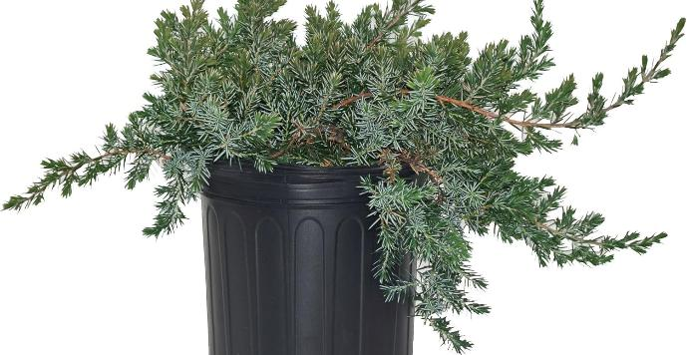
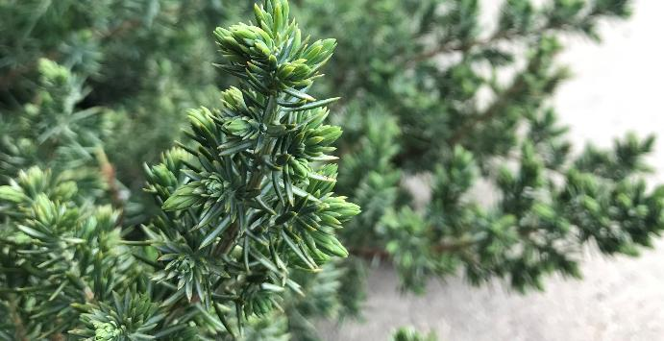
Shore juniper
Evergreen groundcover
blue-green, awl-shaped, prickly needles / not flat like blue rug
White tips to the leaves

Slide 9
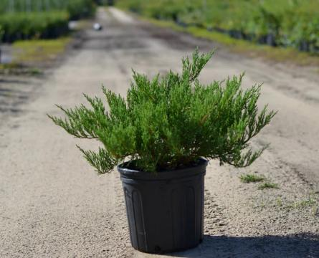
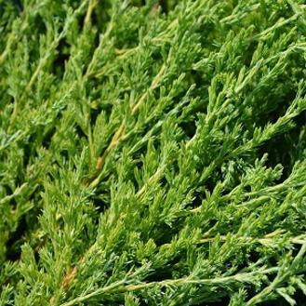
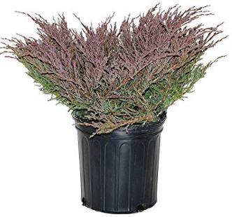
Andorra juniper
Evergreen groundcover
fine, soft, gray-green foliage that often takes on a plum-purple hue in the winter months
Out and up growth pattern
about 18” tall

Slide 10
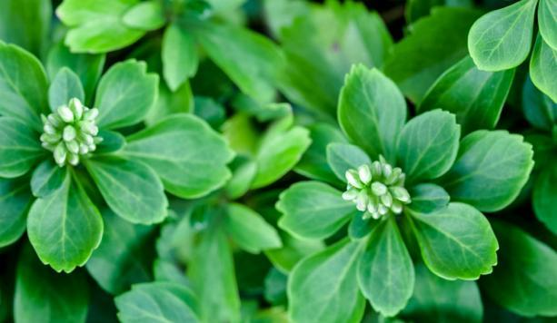
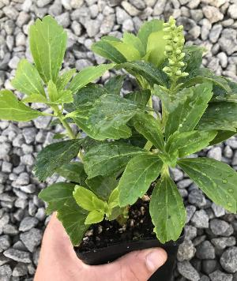
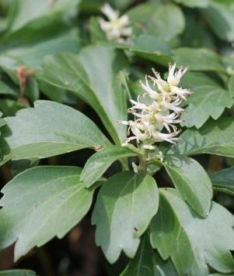
pachysandra
Evergreen groundcover
Whorled leaflets
Scalloped or Serrated at the ends of leaf
Grows 8-12" high
Flowers are small, white, and in 1-2 inch spikes

Slide 11
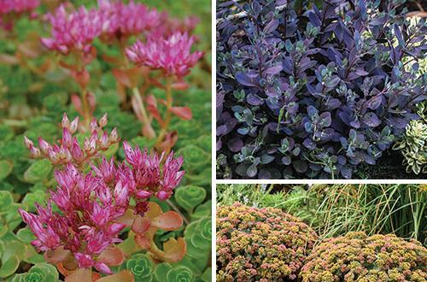
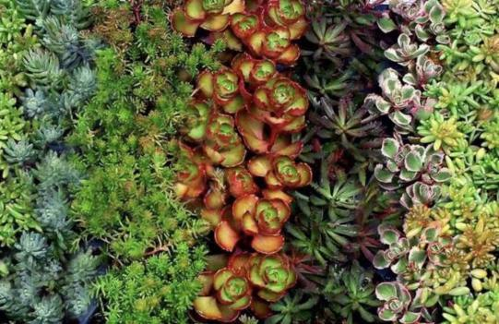
sedum
Small growing perennial
Come in a variety of colors and sizes
Most varieties are low growing and spreading
Have rounded succulent leaves
Leaves are opposite
Most flowers but flowers also range in size and color

Slide 12
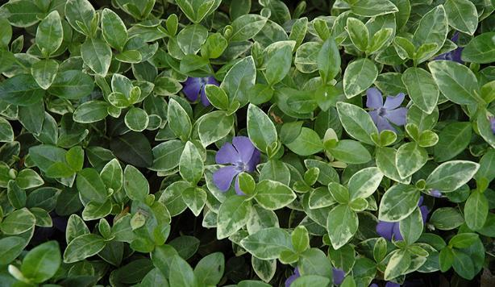
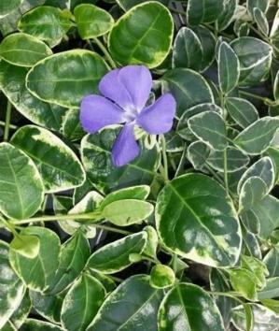
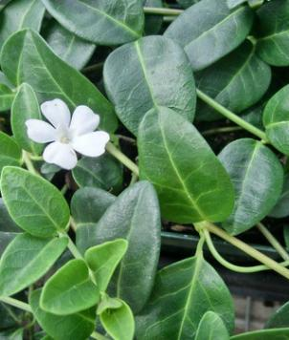
Vinca (periwinkle)
low-growing, trailing evergreen vine
opposite leaves that can be solid green or variegated
Smooth margins and often features a white midrib
Bluish/purple or white 5 petal flowers

Slide 13
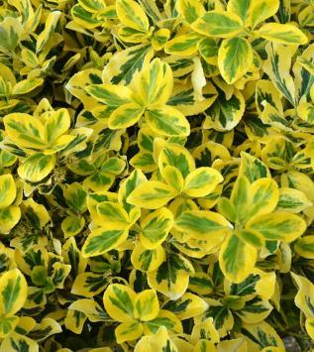
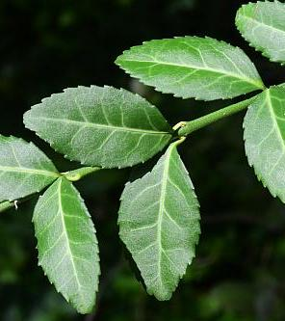
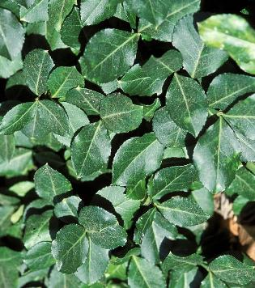
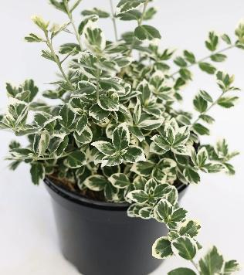
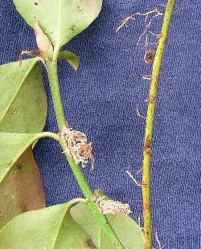
wintercreeper
evergreen to semi-evergreen mounding vine
Opposite, serrated leaves
Often roots form at nodes
Can be multiple colors
Wooden stem, older growth bark like appearance

Slide 14

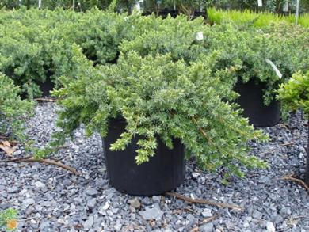
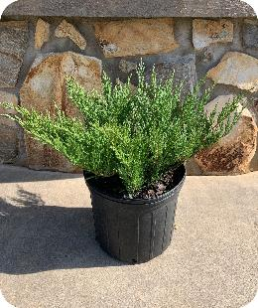
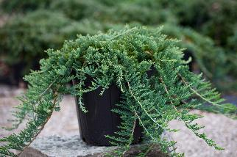
Now let’s compare
Shore Juniper
Blue Rug Juniper
Andorra Juniper
Needles blue/ green
Spikey needles with an awl (circular) shape
Grow slightly up and then spreads out
Shorter then Andorra but taller than Blue Rug
Needles blue/green color
Flat soft needles that spread
Shortest of all 3
Needles gray/green (turn purple in fall)
Soft needles, not flat, grow upward
Tallest of all 3

Slide 15
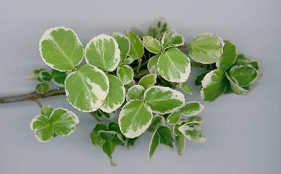
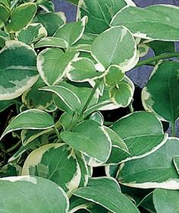
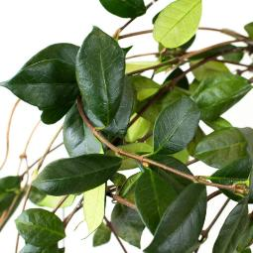
Now let’s compare
Vinca
Confederate jasmine
Winter creeper
Opposite
Solid green or variegated
Smooth edges
Soft, thin leaf
White midrib
Soft green stem
Blue/ purple flowers most common
Opposite
Solid green leaf
Smooth edges
Thick, fleshy (leathery) feeling leaf
Woody slender stem
White flowers
Opposite
Solid green or variegated
Serrated edges
Woody, bark like stem can often see roots
Non-showy flowers

Slide 16
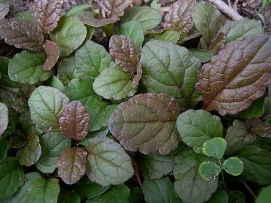
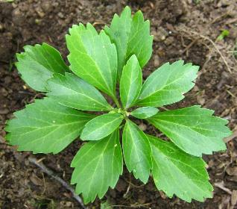
Now let’s compare
pachysandra
Ajuga
Whirled leaf pattern
Scalloped or serrated at the ends
Solid green
Thicker leaf
Tight, dense growth
Leaves purple to bronze or variegated
Soft leaf
Leaves opposite

