Slide 1
Nursery/Landscape Plant Id tips sorted By Category
This is a free resource provided by Georgia Agricultural Education
Original creator: Melissa Riley, Central Region Horticulture Teacher

Slide 2
Deciduous Shrubs

Slide 3
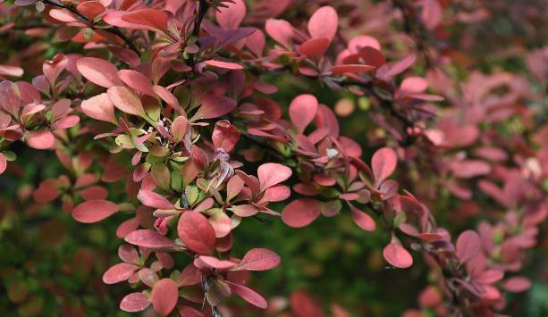
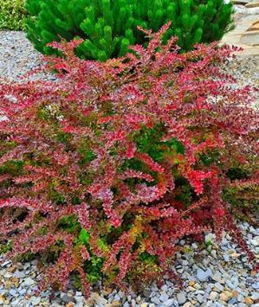
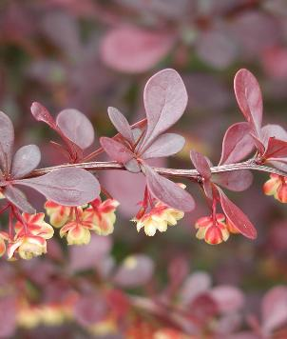
Japanese barberry
Alternate, deciduous leaves
Stem covered in thorns, very visible in the winter but hidden by leaves in spring and summer
Leaves can be maroon to green to yellow
Small flowers and berries

Slide 4
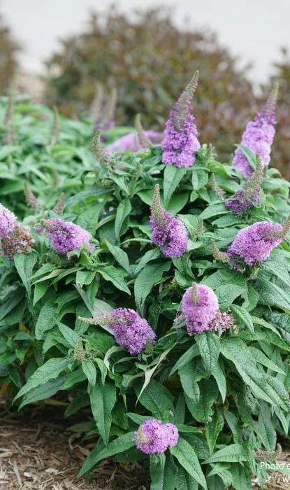
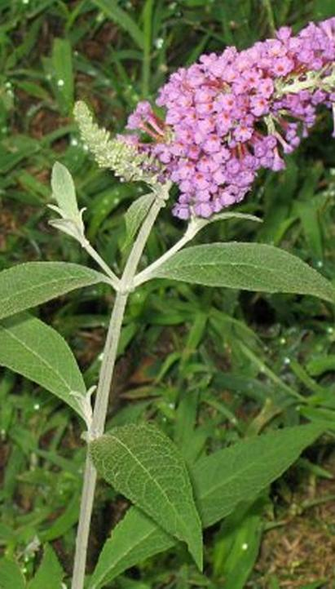
Butterfly bush
Opposite leaves
Deciduous plant
Underside of the leaf is white/greyish color
4-8 sided stem
Blooms in several colors
Large flower spike often remains on plant

Slide 5
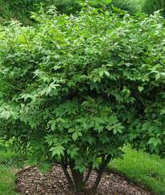
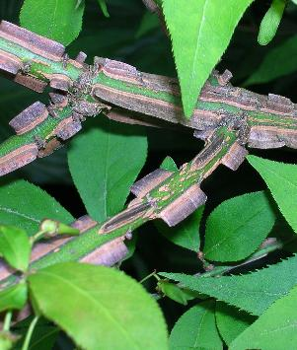
Winged euonymus
“Burning Bush” another name because of red fall color
Deciduous shrub
Corky wings on the bark
Opposite leaves

Slide 6
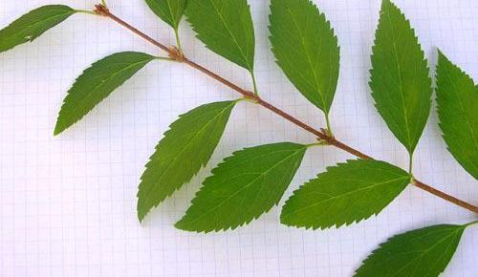
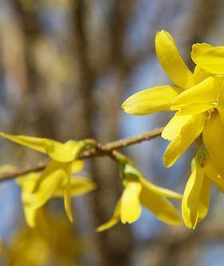
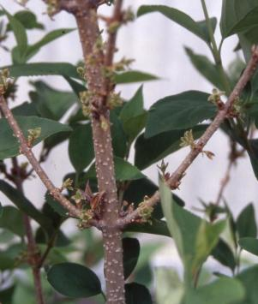
Border forsythia
Opposite buds
Bark is speckled
Hollow stem
Bottom half of leaf smooth, top serrated
Yellow flowers form before leaves

Slide 7
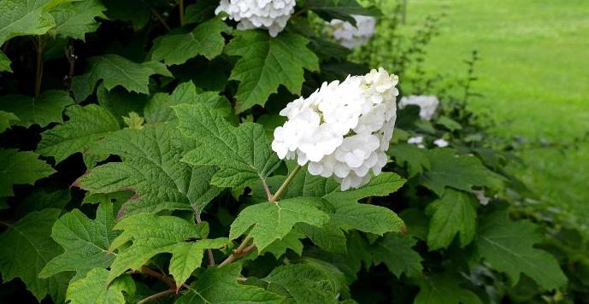
Oakleaf hydrangea
Deciduous shrub
Opposite leaves
Leaves look similar to oak leaf
Large, dark green leaves with silvery undersides and 3–7 lobes
Orangey tint to stem and bark
Older bark peels in thin flakes
Flowers form in clusters/cones of white to pink.

Slide 8
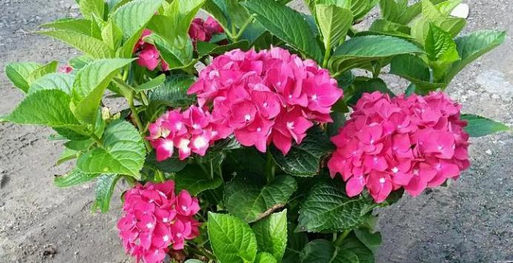
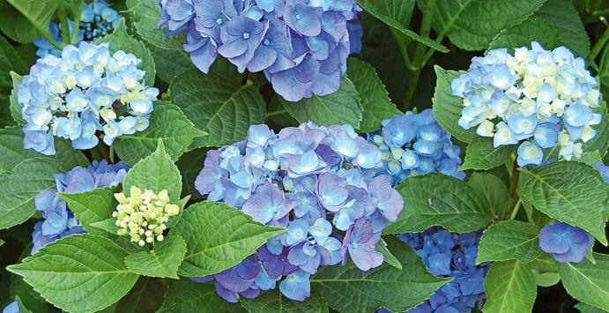
Bigleaf hydrangea
Deciduous shrub
Opposite leaves
Leaves are large, often serrated
Very pronounced veins and a scale-like appearance to leaves
Big, showy flower heads in white, pink, purple or blue

Slide 9
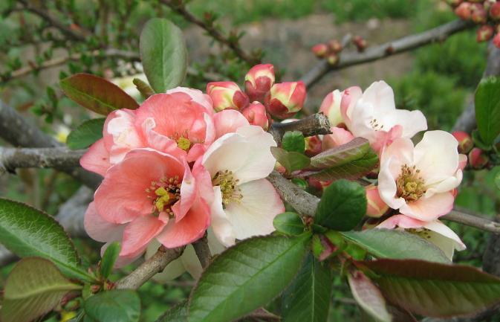
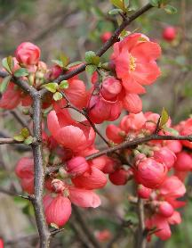
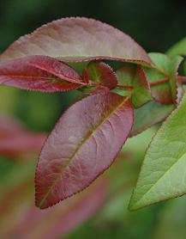
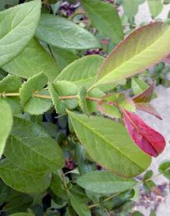
Flowering quince
Alternate leaves
Glossy, dark green, oval to oblong leaves with serrated edges
Large stipules (appear as small leaves at the base of larger leaves)
Thorn and thornless varieties – thorns are often hidden under leaves
Elbows lack of terminal bud
showy, vibrant red, pink, or white flowers that bloom early in spring before the leaves fully appear
Fruit 2” in diameter

Slide 10
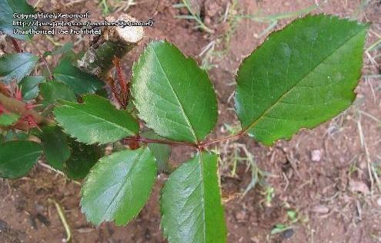
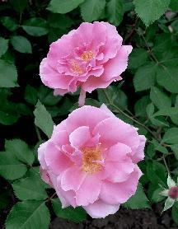
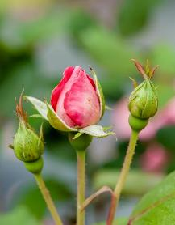
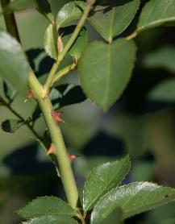
Landscape rose
Alternate, compound leaf
Usually with thorns on the stem
Serrated leaves form in leaflets of typically 5-7
Flower buds have long sepals that overlap before opening
New growth and stems are often red

Slide 11
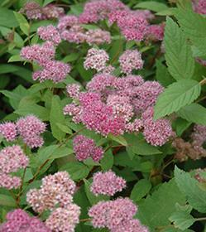
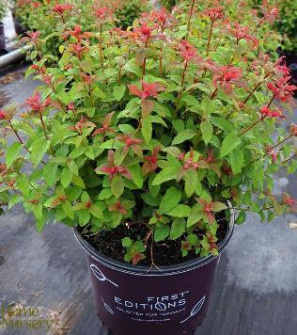
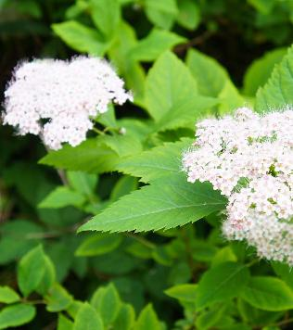
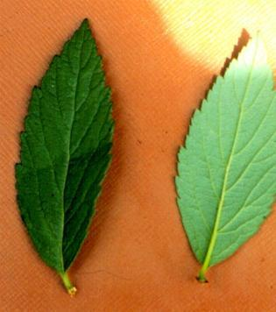
spirea
compact, deciduous shrub
Alternate simple leaf
Lance shaped serrated / sharply toothed leaf
Pronounced midrib on underside of leaf
Variety of flower colors
Leaves emerges with pinkish-purple tints in spring and turns purplish-bronze in fall

Slide 12
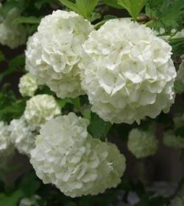
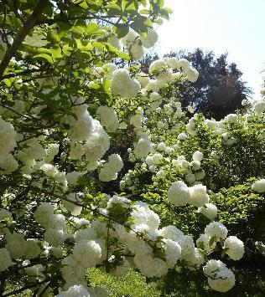
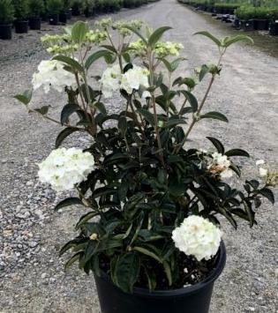
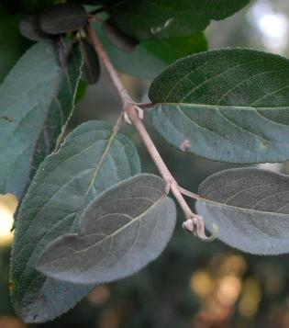
Snowball viburnum
Deciduous, large shrub
Opposite, simple leaves with smooth or lighly toothed edges
Branches are opposite and grow at a 45-degree angle – “forming a V for Viburnum”
large, showy, snowball-like clusters of white flowers

Slide 13
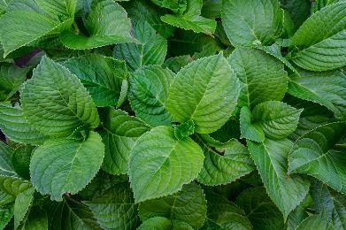
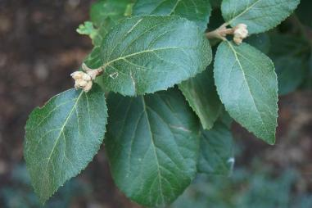
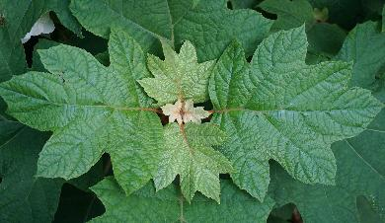
Now let’s compare
Oakleaf Hydrangea
Bigleaf hydrangea
Snowball viburnum
Leaves look similar to an oak leaf
silvery undersides and 3–7 lobes
Leaves are large, with serrated edges
Very pronounced veins and a scale-like appearance to leaves
simple leaves with smooth or lightly toothed edges
Branches are opposite and grow at a 45 degree angle – “forming a V for Viburnum”

Slide 14
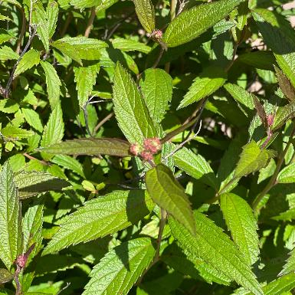
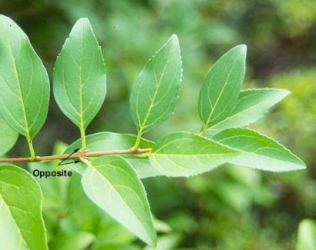
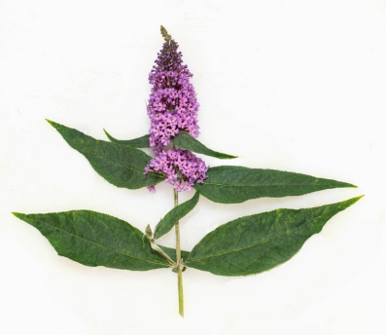
Now let’s compare
Spirea
Forsythia
Butterfly Bush
Opposite!
Lighter green leaf
Top half serrated; bottom edges smooth
Speckled bark
Hollow stems
Alternate!
Darker green leaf
Serrated edges
Dark, smooth bark
Opposite
Narrow leaf
Both smooth and serrated varieties
White/gray, fuzzy texture on the underside

