Slide 1

Nursery/Landscape Plant Id tips sorted By Category
This is a free resource provided by Georgia Agricultural Education
Original creator: Melissa Riley, Central Region Horticulture Teacher

Slide 2
Evergreen shrubs

Slide 3
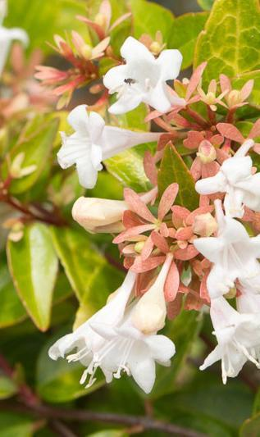
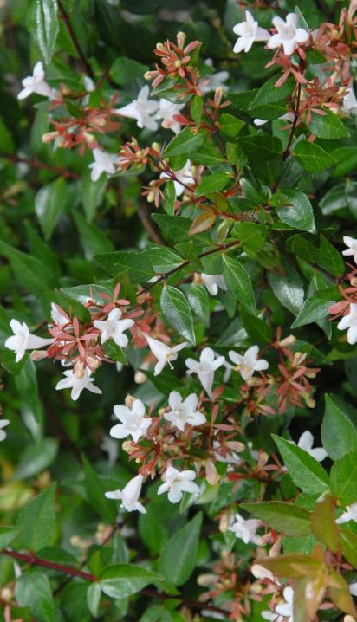
Glossy Abelia
Opposite leaves
Upside down raindrop or teardrop shape
Flowers trumpet shaped

Slide 4
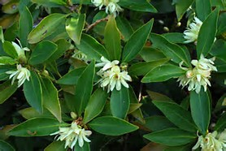
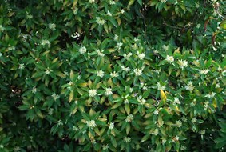
Japanese anisetree
Aromatic- alternate leaves
Evergreen tree/shrub
Arranged somewhat perpendicular to the stem
When crushed, leaves smell like black licorice

Slide 5
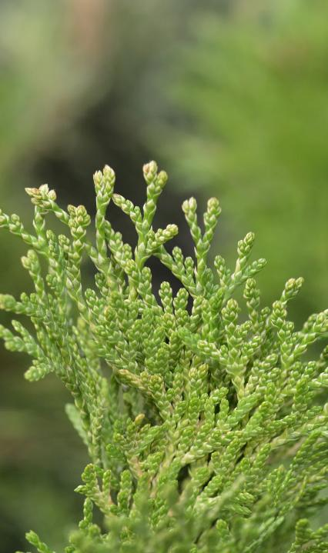
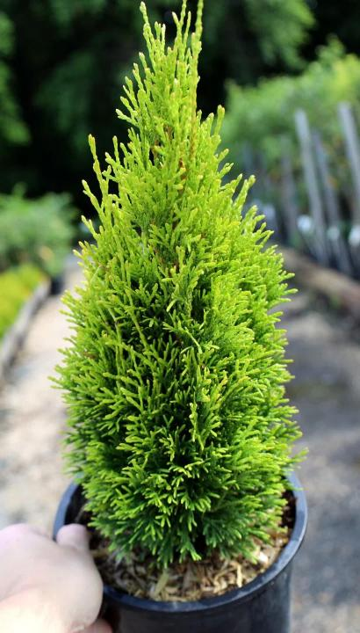
arborvitae
Grows 12-14 feet tall
deep and rich green color year-round,
foliage grows in flat sprays
close up, the needles appear covered in fine green scales.

Slide 6
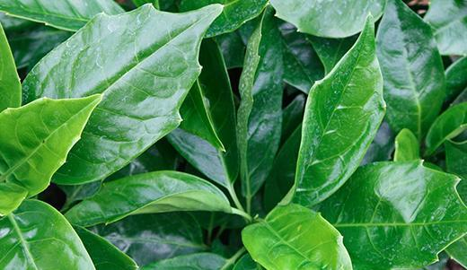
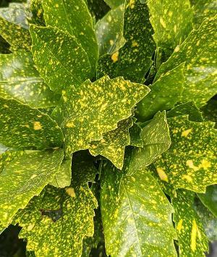
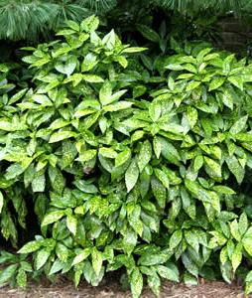
Japanese aucuba
Opposite evergreen leaf-
Leaves have a plastic or waxy texture
Can be green or variegated
Slightly serrated edges

Slide 7
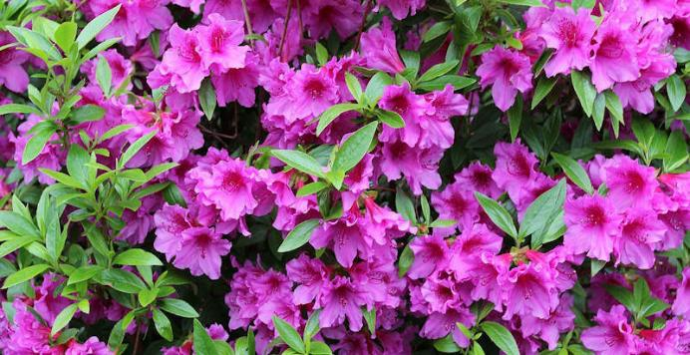
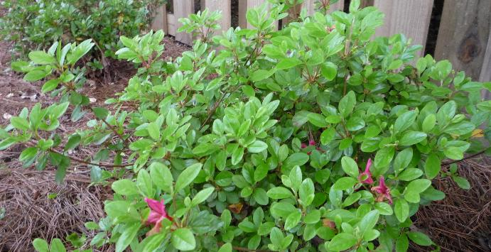
azalea
Evergreen with dull green leaves
Pubescent / leaves are fuzzy
Growth is always at the end of the stems, center of plant has no foliage
Flowers in many different colors
Flowers form in groups/clusters

Slide 8
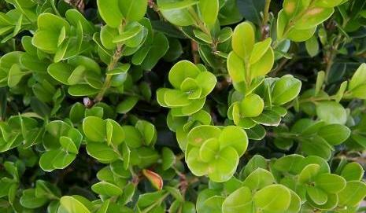
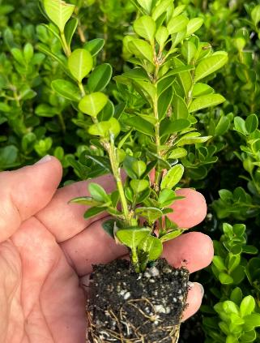
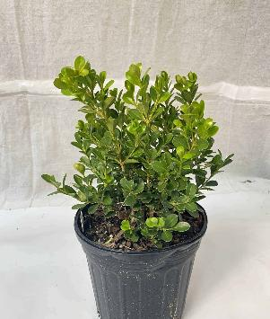
boxwood
Opposite leaves
Has a distinct (often unpleasant) smell
Often square with stem groove
The midrib on the bottom of the leaf is often white (most varieties)

Slide 9
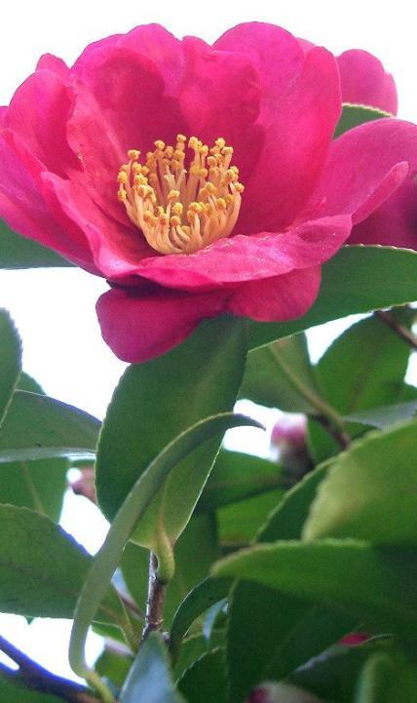
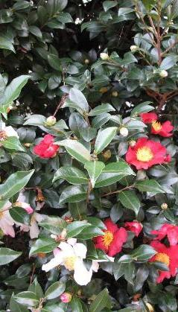
Sasanqua camellia
Smaller than Japonica – 6-14 feet tall
Serrated, dark green leaves, leaves are also alternate
Plastic, Waxy feeling leaves
Curved petiole around bud
Delicate flowers with exposed stamen as the flower opens

Slide 10
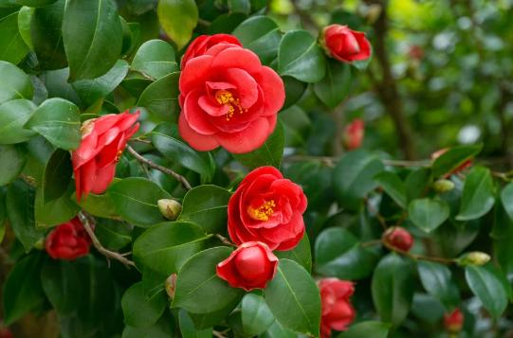
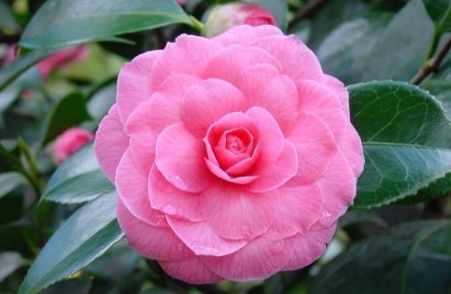
Camellia, japonica
Evergreen shrub, larger than sasanqua 6-25 feet tall
Serrated, dark green leaves, leaves are also alternate
Plastic, Waxy feeling leaves
Black glands(dots) on tips of serrations

Slide 11
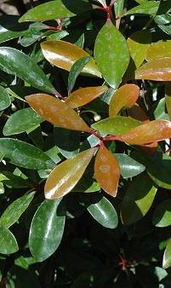
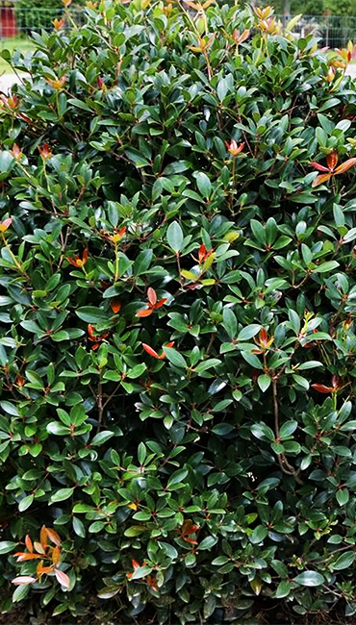
Japanese cleyera
Alternate leaf arrangement
Evergreen shrub
Red petiole
Leaves form in a whorled patter
Glossy leaves

Slide 12
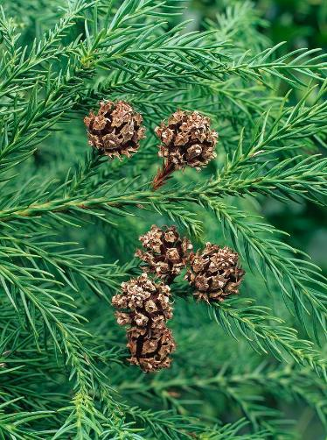
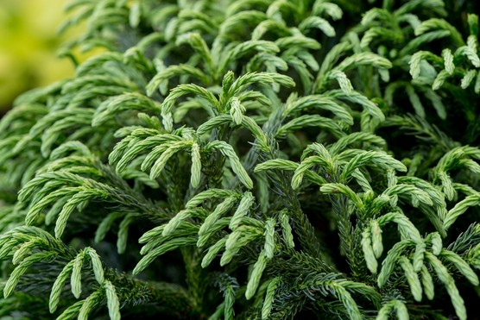
Cryptomeria
Evergreen conifer tree
Soft, needle like foliage
Foliage spirally (circular) arrangement on stem
Cones form only on ends of branches

Slide 13
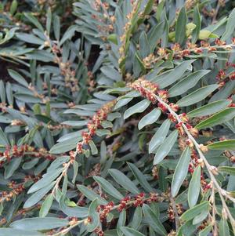
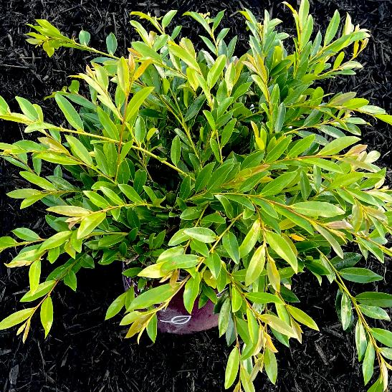
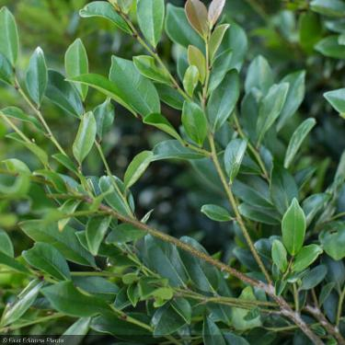
distylium
Compact, evergreen shrub
Small flowers form at the base of the leaves, typically red
Oval, alternate foliage that is light to dark green
Upright to weeping growth pattern

Slide 14
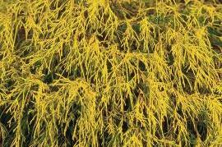
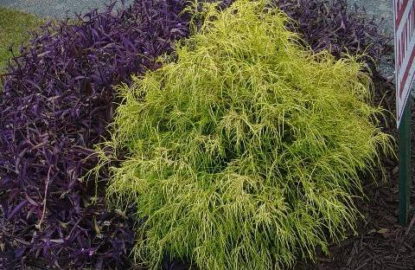
golden mop threadleaf False cypress
Evergreen
Flat not sharp like juniper
White X on back unlike arborvitae
Yellow (golden) in color

Slide 15
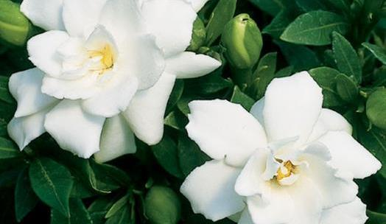
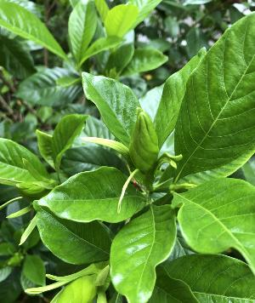
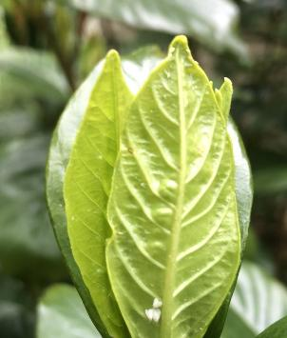
Cape jasmine gardenia
Opposite leaves
Evergreen
Ribbed veins on the backside of leaves
Flower buds appear rolled with long protective leaves protecting the bud

Slide 16
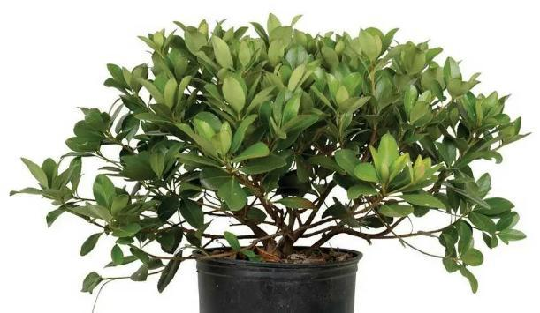
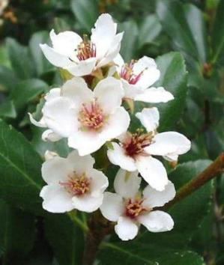
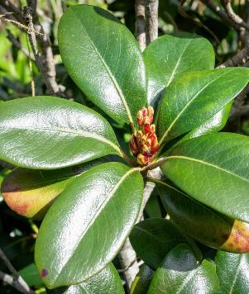
Indian hawthorn
Alternate leaves that are slightly serrated
Evergreen rounded shrub
Sometimes purple margins
Often looks whorled at ends
Flowers can be white or pink, with dark berries in the fall

Slide 17
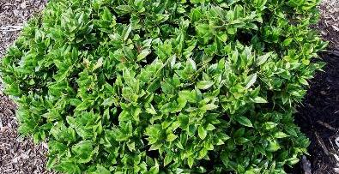
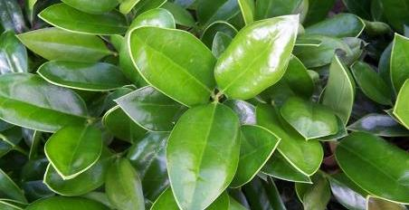
Carissa holly
Compact, evergreen shrub
Alternate leaves
Leaves are hard and glossy
leaf curved up
Distinct line around outside of leaf

Slide 18
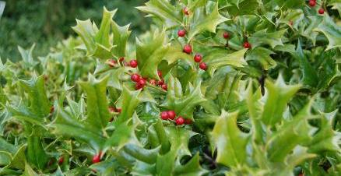
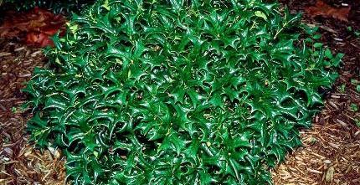
Chinese holly
Broadleaf evergreen shrub
Alternate leaves
7 spines/points on leaves
  C-H-I-N-E-S-E
Dark green, glossy leaf

Slide 19
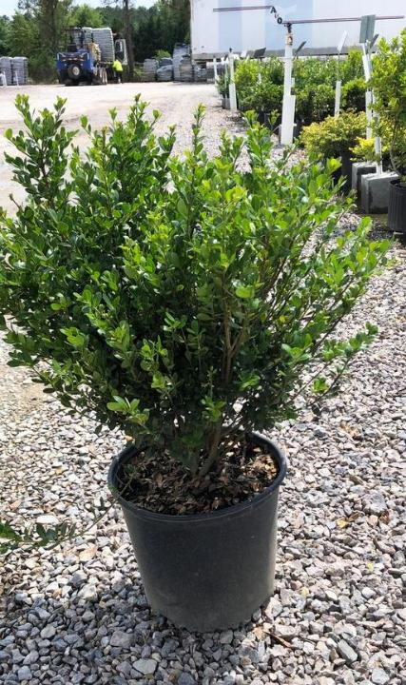
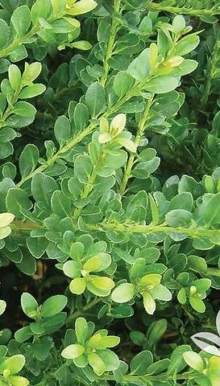
Compacta holly
Evergreen shrub
Alternate leaves
Leaves are rounded, older leaves are also slightly toothed at the ends
Dark glands on the underside of the leaf
Candleabra-shaped appearance

Slide 20
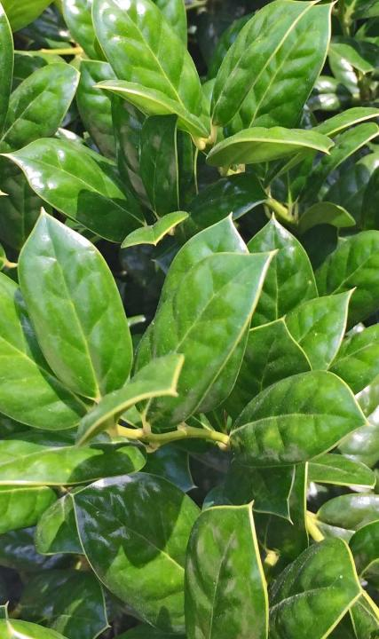
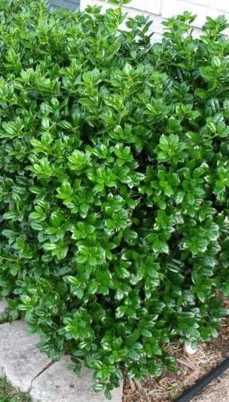
Dwarf burford holly
Evergreen shrub
Alternate leaves
Leaf cups down or is bent over
Leaves narrow to point at the end, rounded at the bottom

Slide 21
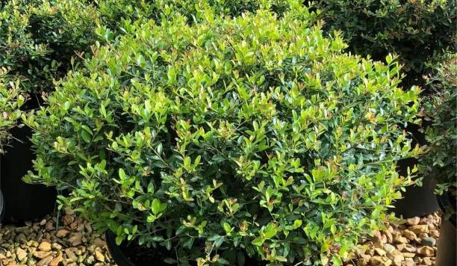
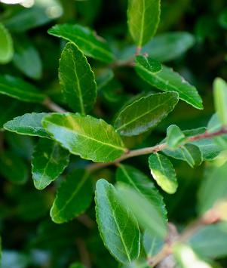
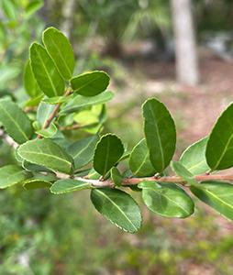
Dwarf yaupon holly
Evergreen shrub
Football-shaped leaves, slightly scalloped on edges
Purple to gray stems
New growth has purple tint

Slide 22
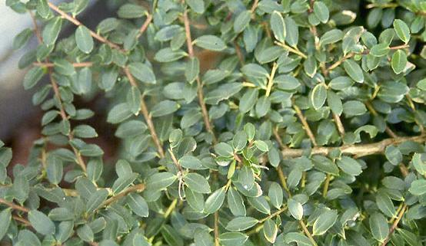
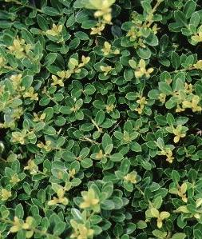
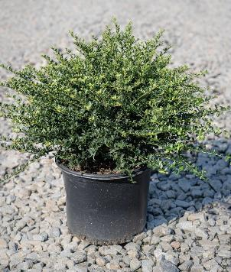
Helleri holly
Evergreen shrub
Dark glands on back of the leaf
Rounded shape but stems cross over each other / Horizontal type growth
Obovate, evergreen leaves - 0.5 inches long and have a few crenate teeth at the tips of the leaves

Slide 23
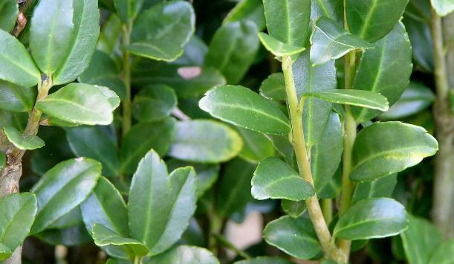
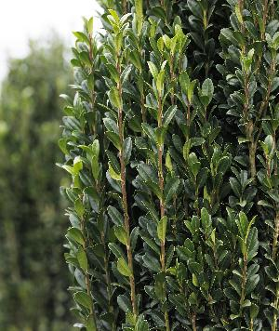
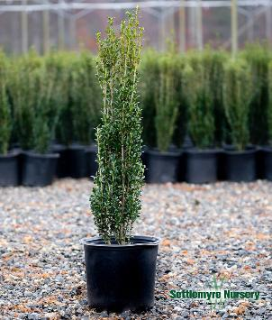
Sky pencil holly
Slender-vertical type growth
Dark glands on back of leaf
Leaves also grow upright
Leaves have slightly scalloped edges

Slide 24



Savannah holly
Type of foster holly / Large shrub often pruned into a tree
Large red fruit/abundant fruit producer
Spiny edges on the leaves
Leaves are not as thick as other holly varieties
Leaves are larger than other hollies, 1-3 inches in length

Slide 25

Weeping yaupon holly
Evergreen shrub
weeping / drooping branches that cascade downward from the trunk
Football-shaped leaves with slightly scalloped edges
Purple to gray stems

Slide 26



Ligustrum, sunshine
Compact, evergreen shrub with vibrant, golden-yellow foliage
Does not produce flowers or seeds
Bright, glossy, golden yellow leaves
Leaves have wavy edges
Stem on new growth can have reddish tint

Slide 27



loropetalum
Evergreen shrub
Alternate leaves
Leaf veins pronounced
Rough pubescent (hairy) texture
Leaves purple to green in color
Flowers look fringed and are pink/white
Flowers form at the end of the stem or base of the leaf

Slide 28




Leatherleaf mahonia
Leaves are alternate and form what look like wings
distinctive, holly-like, pinnately compound leaves that have sharp teeth along the edges
Yellow flowers with a blue fruit spike

Slide 29


Dwarf nandina
Leaves form in clusters of 3 at the end of the stem
Usually less than 30”
Shorter internode than Nandina
Red fall color
Bamboo-like stems

Slide 30




nandina
Alternate bipinnate to tri-pinnate leaves
3 leaves at the end of the stem
grows to 4-8' tall
Longer internodes than dwarf
Often leggy with cane-like stems resembling bamboo
small white flowers in spring followed by bright red berries that persist through winter

Slide 31



Tea olive osmanthus
Evergreen shrub
Opposite, simple leaf
Glossy, oval-shaped, leathery green leaves
Distinct vein on the underside of leaf
Leaf margins may be smooth or finely toothed
Fragrant white flower

Slide 32




pieris
Alternate simple leaves
Evergreen
Slightly Serrated
New growth often reddish/whorled
Mass of bell shaped flowers
Brown to black “knots” at the nodes
White mid-rib

Slide 33


Mugo pine
Needles in pairs
Needs up to 3” long
Typically low-growing shrub pine

Slide 34




Japanese pittosporum
Rounded, evergreen shrub
Alternate simple leaf
Leaves are leathery and glossy, with downward rolled margins
Can be solid green or variegated
Distinct midrib

Slide 35





plumbago
evergreen, sprawling shrub - slender, climbing stems
clusters of delicate, pale blue, trumpet-shaped flowers
glossy green, spoon-shaped leaves with a distinctive ear-shaped base
Leaves grow in clusters with long spacing between nodes
Flower buds appear to have small hairs or spikes

Slide 36




Variegated privet hedge
evergreen or semi-evergreen shrub
Opposite leaves
oblong oval (football) shaped leaves
Sporadic dense (thick) growth pattern
Always Variegated
Leaves are green in center with white margins, occasionally have dark green spots randomly on the outside edge of the leaf

Slide 37




rhododendron
Evergreen shrub
Alternate, simple leaf
Oblong leaves almost in whorls
Dark green almost glossy above, paler below
Leaves are long and leathery
New growth grows more upright where older leaves cup downward
Gray-brown bark that develops fine scales with age
Flower buds are cone or scale like in appearance

Slide 38



Sago palm
Pseudo whorl
Thick, shaggy - unbranched trunk
Glossy, arching, fern-like leaves
Pointed leaflets that curl slightly at the edges

Slide 39




Bayberry wax myrtle
Small, evergreen shrub or tree
Flat, toothed, and fragrant when crushed
Leaves are slightly twisted
Small round drupe purplish attract directly to the branch under the leaves
Spikes often remain on the stem where fruit has been

Slide 40




Plum yew
Evergreen shrub
Can be upright or spreading
Linear leaves arranged in 2 planes
  V-shaped leaf pattern on a branch
2 gray bands beneath the leaf

Slide 41




Yucca (adams needle)
Leaf sword-like
Dark green and variegated varieties
Typically has threaded-like needle at the end of the stem
Filament peeling – looks like hairs
White flower spike – flowers are bell-shaped

Slide 42



Now let’s compare

Slide 43



Now let’s compare

Slide 44




Now let’s compare
Arborvitae
Cryptomeria
Golden Mop False Cypress
Flat, scale-like foliage
Fan-shaped, with a smooth, soft texture
Typically bright green
Needle-like foliage
Spirals around the stems
Foliage feels slightly prickly but is not sharp
Bright green in spring and summer; may turn reddish-brown in winter
Thread-like, wispy foliage
Foliage is thin and stringy, giving a mop-like appearance
Golden yellow to lime green, particularly vibrant in full sun.

Slide 45


Now let’s compare
Carissa Holly
Burford Holly
leaves are smaller, more oval
They are more pointed at both the base and the tip
Distinct line around outside edge of leaf
Leaves cup up
leaves are larger, broader and glossy
They are more rounded at the bottom and pointed at the top
Leaves cup down

Slide 46



Now let’s compare
Helleri holly
Yaupon holly
Compacta holly
Leaves are tiny, flat, oval leaves few crenate teeth at the tips
Dark glands on the back of the leaf
Stems cross each other – horizontal growth pattern
Small, rounded to oval(football-shaped) leaves with smooth or slightly serrated edges.
New growth and stem reddish/purple
Similar to Helleri but slightly larger, oval leaves
The foliage is also glossy and bright green.
More rounded/ bowl shape

Slide 47



Now let’s compare
Yaupon holly
Boxwood
Variegated privet hedge
Alternate leaves
Small, rounded to oval(football-shaped) leaves with smooth or slightly serrated edges.
New growth and stem reddish/purple
Opposite leaves
Solid green leaf (most common)
White midrib on underside of leaf
Opposite leaves
Always Variegated
Leaves are green in center with white margins, occasionally have dark green spots randomly on the outside edge of the leaf

Slide 48




Now let’s compare
rhododendron
Indian Hawthorne
Japanese cleyera
pittosporum
Larger, elongated oval leaves (3–6 inches long)
Narrower at the base, tapering toward the tip
Often slightly curved downward along the edges
Leaves are larger and more spaced out
Small to medium-sized leaves (1–3 inches long)
Oval or oblong with a slightly rounded tip
Grow in clusters
Larger, elongated oval leaves (2–4 inches long)
Broad with a pointed tip
New growth may appear reddish-bronze before maturing to green.
Alternating leaves down stem
Medium-sized, spoon-shaped leaves (2–5 inches long)
Broadest near the tip, with a rounded or slightly notched end
Sometimes variegated
Whorled at branch tips

