Slide 1

Nursery/Landscape Plant Id tips sorted By Category
This is a free resource provided by Georgia Agricultural Education
Original creator: Melissa Riley, Central Region Horticulture Teacher

Slide 2
Flowering Perennials

Slide 3
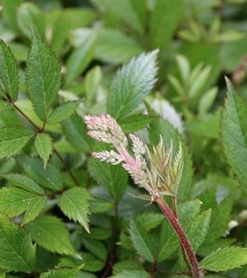
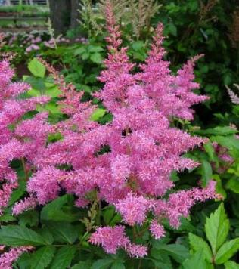
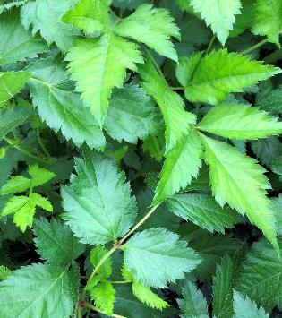
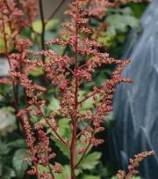
astible
Herbaceous perennial
Finely divided leaves resembling a fern
Plume-like flower spikes that can be upright or slightly arching, available in a range of colors
Flowers spike often remain after blooming throughout the winter

Slide 4
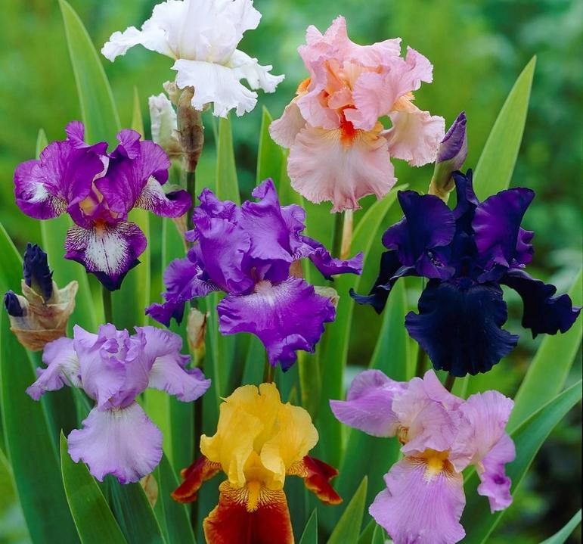
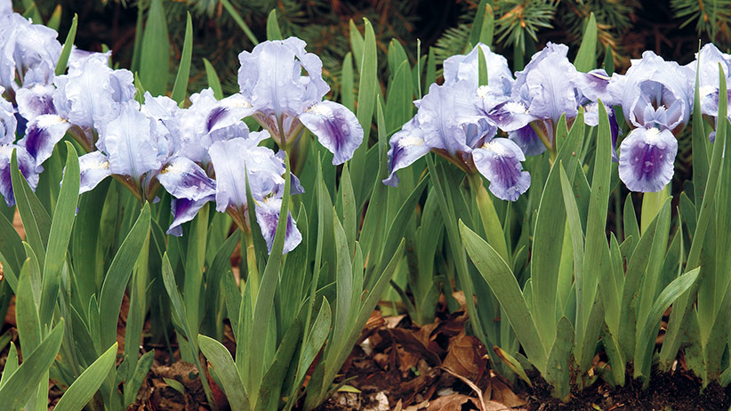
Bearded Iris
a perennial flower
large, showy blooms with three upright petals and three downward-facing petals and a fuzzy "beard" running down the middle
Flowers in many colors
sword-shaped leaves that overlap each other in a fan shape

Slide 5
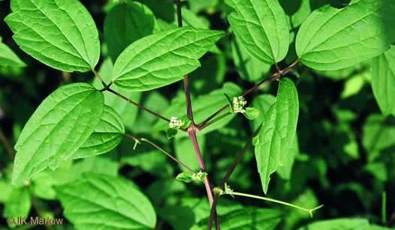
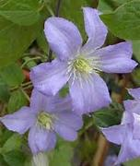
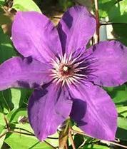
Clematis
Can be both and evergreen or deciduous vine
Terminal leaflets in 3’s
Usually staked on trellis or poles
Blooms in a variety of colors
Very fragile, small stems

Slide 6
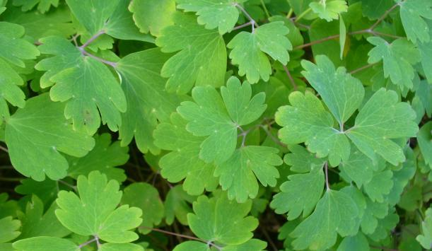
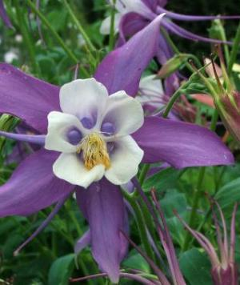
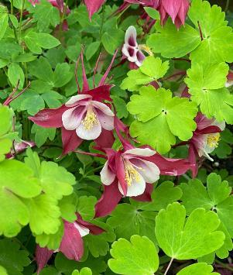
columbine
Shade perennial
3-part serrated leaf
Leaves are slightly lobed
Flowers in different colors
Five-petaled flowers that have long backward-extending spurs

Slide 7
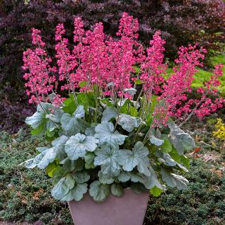
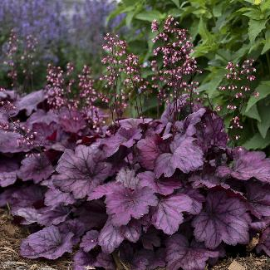
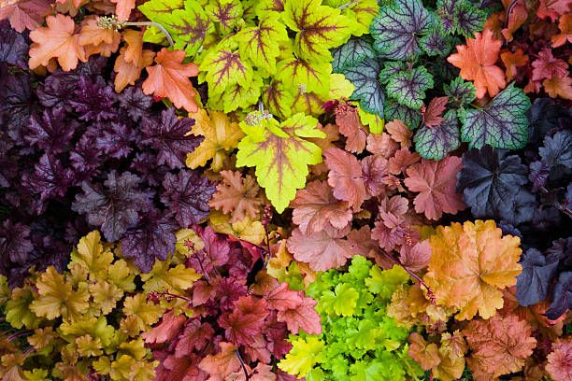
Coral bells
low-growing, clump-forming perennial plant
Heart shaped or triangle shaped leaf
colorful foliage in shades of green, purple, or copper
small, bell-shaped flowers on slender stems rising above the leaves
Leaf pattern varies
Veins are often prominent and contrasting with the leaf color

Slide 8
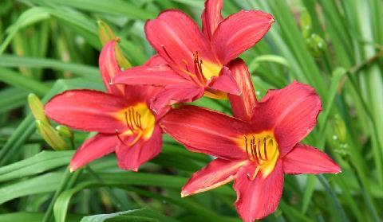
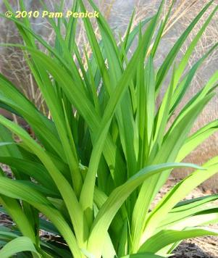
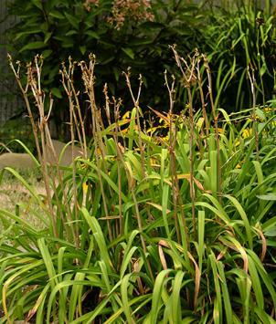
daylily
Herbaceous perennial
Leaves cupped with a pronounced center vein
Sometimes, dead flower spike remains

Slide 9
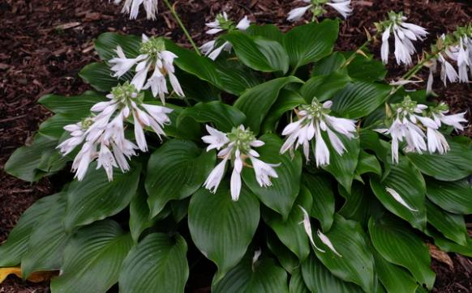
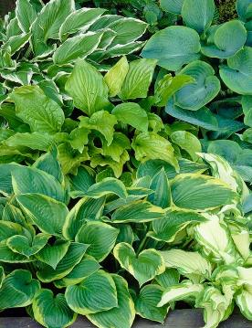
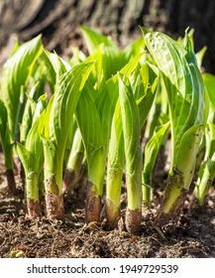
hosta
Perennial-shade plant
Parallel veins
Many varieties with different shades of green, blue, gold, and white and leaf shapes
New growth emerges as spikes and uncurls as it grows
Trumpet-shaped flowers form on a spike, usually bloom white or purple

Slide 10
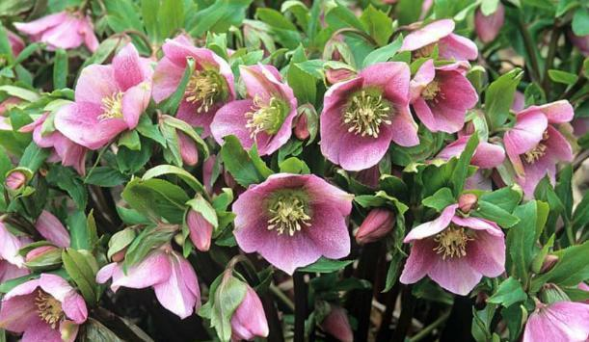
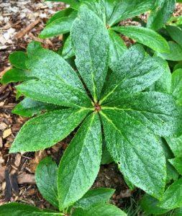
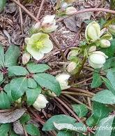
Lenten rose
Shade perennial
Soft stems often bend or fall over
Leaves palmate with 5-6 lobes
Flowers have overlapping petals.
Flowers can range from white to pink or light purple, often with spots inside and exposed stamen

Slide 11
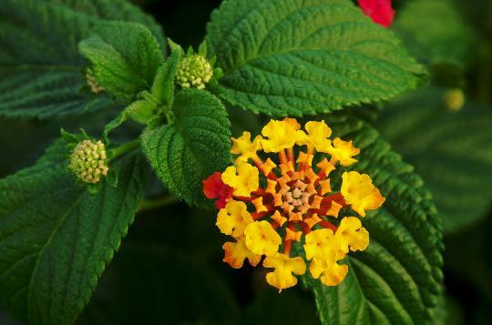
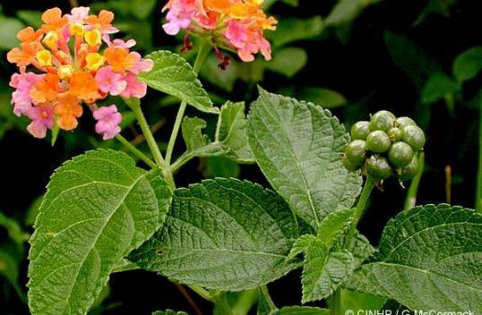
lantana
Summer sun perennial – can be both evergreen and deciduous depending on variety.
Fragrant shrub or groundcover
Scratchy leaves (can cause an allergic reaction)
Leaves are oval shaped and opposite
Woody stems
Vibrant, clustered blooms that can be multiple colors within a single cluster

Slide 12
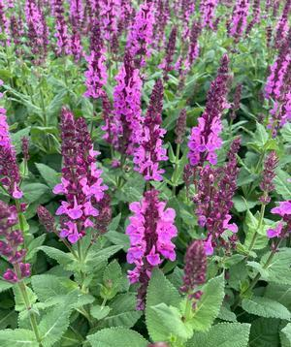
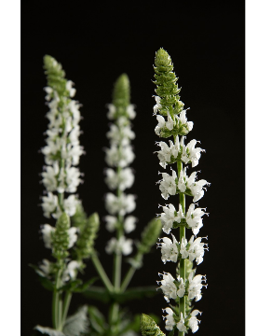
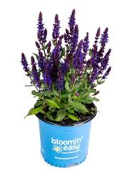
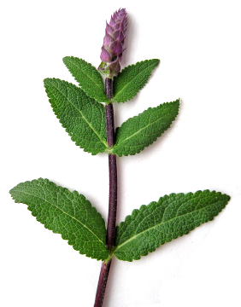
salvia
Herbaceous perennial
Hardy
Medium green to gray-green leaves with a slightly wrinkled texture
Leaves are opposite, are rough/ scratchy, and attached directly to the stem with little to no petiole
Tall flower spike- Purple is most common but new varieties can be found with white and pinkish flowers

Slide 13
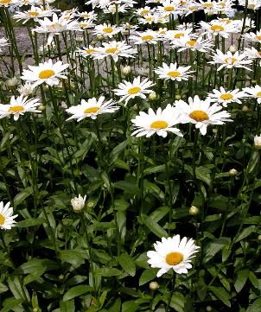
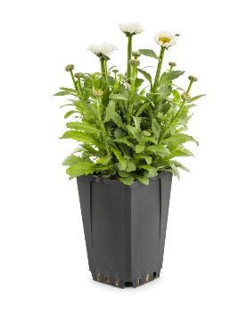
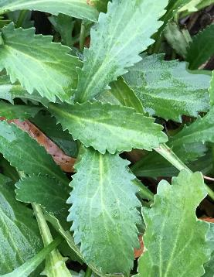
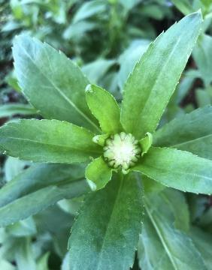
Shasta daisy
perennial flowering plant
large, daisy-like blooms – only blooms white w yellow center
Leaves are dark green, slightly fleshy feeling, oblong in shape, and coarsely toothed along the edges
Leaves are typically large at the base of the plant and become smaller as they progress up the flowering stems

Slide 14
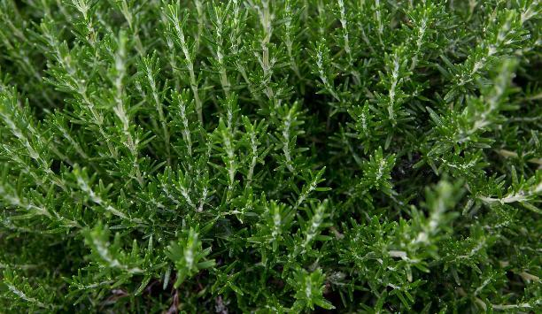
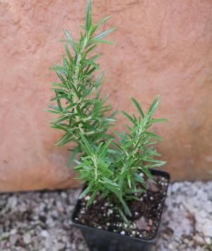
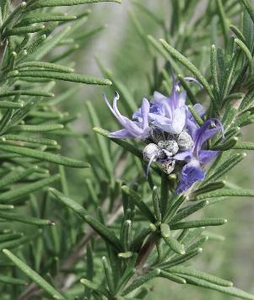
Rosemary
Woody perennial herb
thick, leathery leaves resemble needles,
Needles have a dark green upper surface and powdery white, hairy underside
Stems, especially on new growth, are a grey color
Upright growth pattern
Very fragrant
Can flower - range from pale blue to purple
Can get 4-6 feet tall

Slide 15

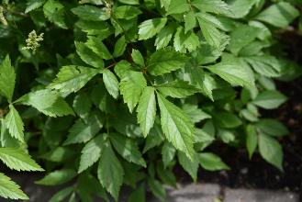
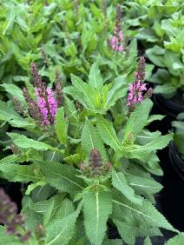
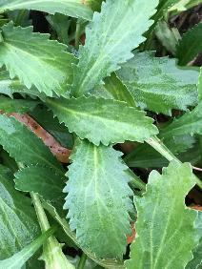
Now let’s compare
Astible
Salvia
Shasta Daisy
Compound leaf
Finely divided leaves resembling a fern
Leaves are opposite
Soft leaf with Rough/scratchy texture
Little to no petiole
Leaves are smooth with fleshy (thicker) texture
Coarsely toothed edges

Slide 16
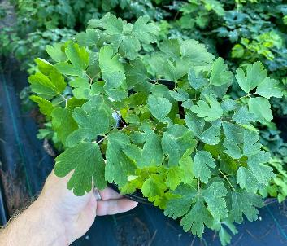
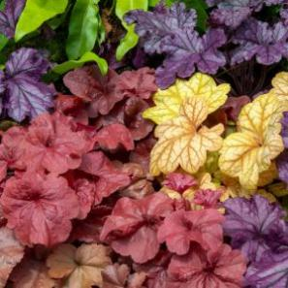
Now let’s compare
Coral bells
Columbine
Single leaf
Heart/triangle shaped leaf
Leaf can be smooth, ruffled, or wavy
Diverse colors , including shades of green, purple, silver, or bronze.
Veins are often prominent and contrasting with the leaf color
3 part separated leaf
Slightly lobed leaf
Solid green leaf

