Slide 1

Nursery/Landscape Plant Id tips sorted By Category
This is a free resource provided by Georgia Agricultural Education
Original creator: Melissa Riley, Central Region Horticulture Teacher

Slide 2
Ornamental grasses

Slide 3
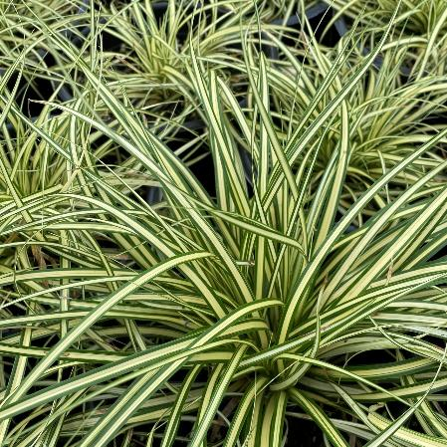
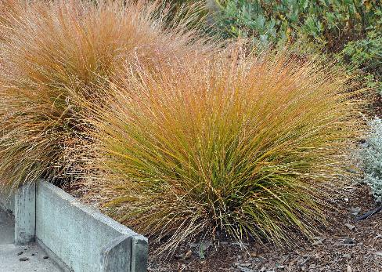
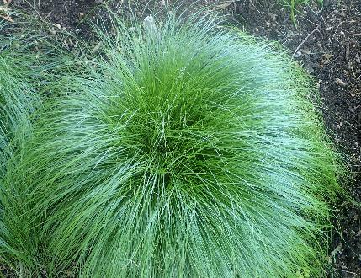
carex
Grass-like with narrow leaves, often forming clumps or tufts
In the sedge family so has a sharp triangular shaped stem edges
Often weeping leaves

Slide 4
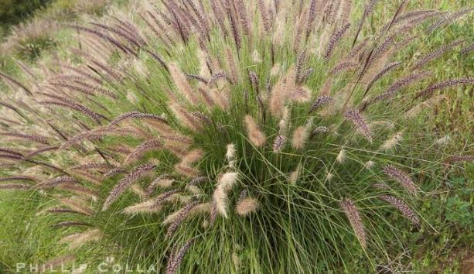
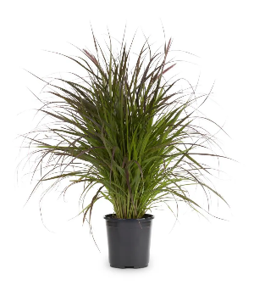
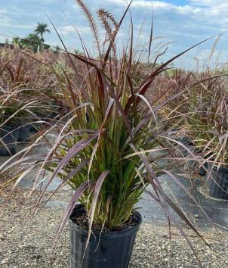
Fountain grass
Tender perennial
ornamental grass
Leaves have a purple tint
Long linear leaves
Clumps with plume flowers

Slide 5
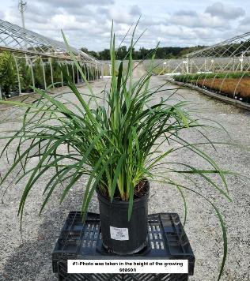
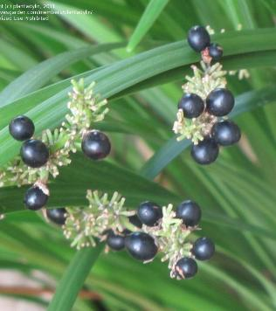
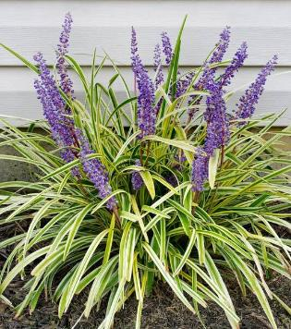
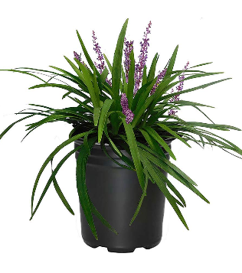
liriope
Herbaceous
Clump/grass-like – can be dark green or variegated
Flat leaf, does not cup like daylily
Upright flower spikes that can be purple, lavender, pink, or white depending on the variety
Forms berries that can leave a spike
Leaf has parallel veins
grows 12-18" tall

Slide 6
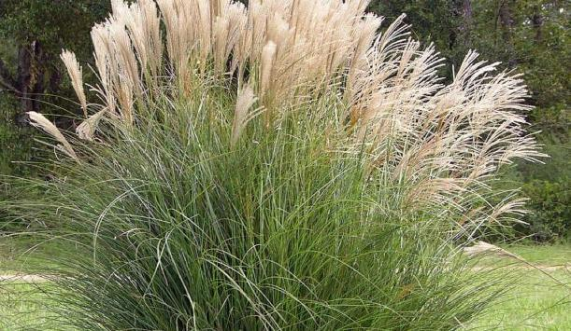
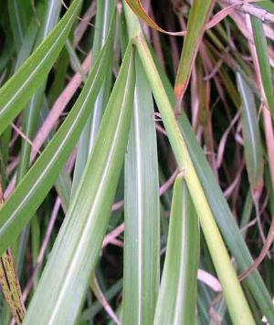
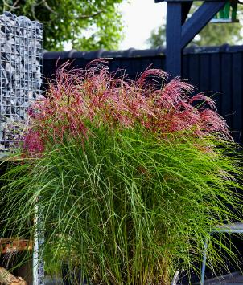
miscanthus
Tall, clump-forming ornamental grass
Typically grows to 3-7' tall
Long, slender, arching leaves featuring a silvery midrib
Feathery, plume-like flower panicles that can be pink to red in color
Also known as maiden grass or Chinese silver grass

Slide 7
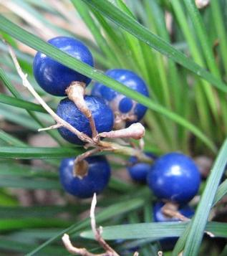
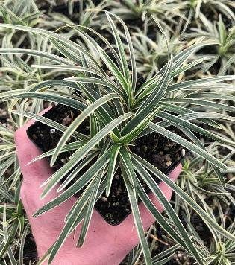
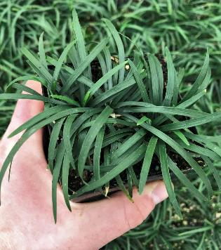
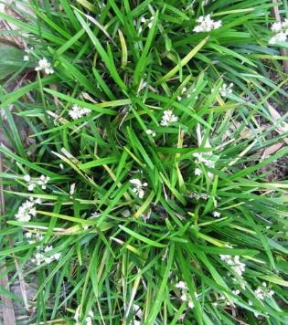
Mondo grass
Grass-like, narrow, dark green leaves that form arching clumps
Shorter stems that liriope
Parallel veins
Blue berries/fruit
Small, bell-shaped, pale lilac to white flowers
8-12” tall

Slide 8
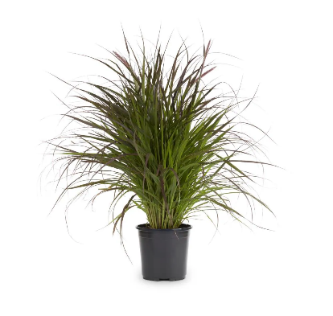
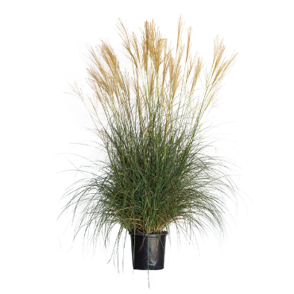
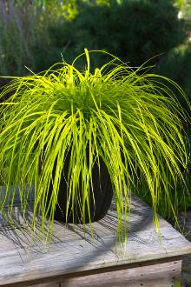

Now let’s compare
carex
Fountain grass
Miscanthus
sharp triangular stem edges
Different colors
Range from 10 inches – 2-3 feet tall
Leaves are green with purple tint
3-4 feet tall
Long, slender, arching leaves featuring a silvery midrib
3-7’ feet tall

Slide 9
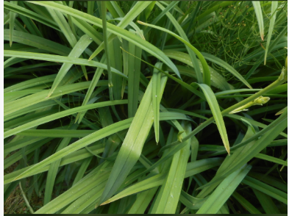
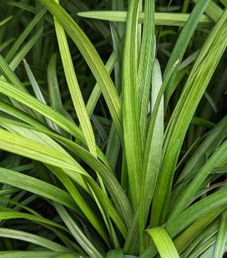
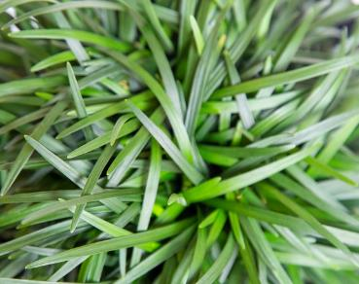
Now let’s compare
Liriope
Mondo Grass
Daylily
Flat leaf – no center vein
Wider than Mondo
12-18 inches tall
Flat leaf – no center vein
Thinner than Liriope
8-12 inches tall
Leaves are cupped with a center vein

Slide 10
Lawn Grasses

Slide 11
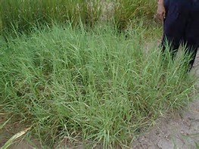
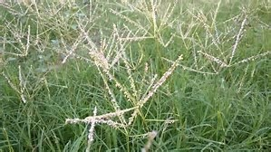
Bermudagrass hybrid
Warm season grass with runners
45 degree angle

Slide 12
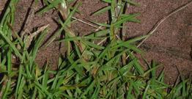
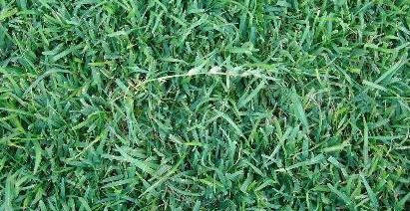
centipedegrass
Warm season grass
Wide flat blades
Alternate arrangement
white midrib/runners

Slide 13
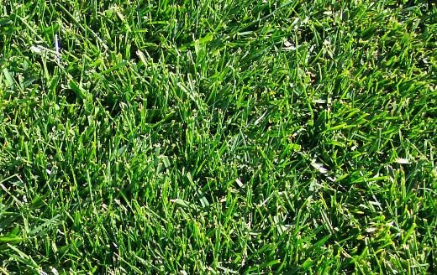
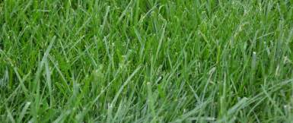
fescue
Cool season grass
Clumps no runners
Serrated backward
Collars around stem

Slide 14
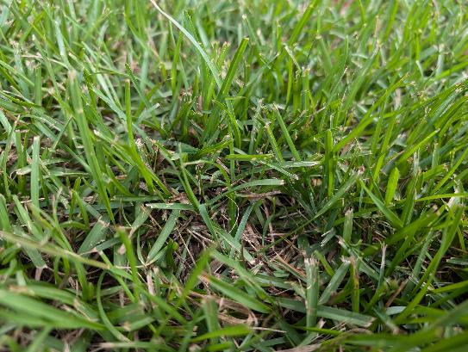
Emerald zoysia
Leaves typically
80-90 degree angle
Smaller than centipede
Usually smooth to touch

Slide 15
Now let’s compare
Bermuda Grass
Slightly pointed tips and short leaves, typically less than 4 mm wide.
Bright green to dark green.
The leaf blades grow flat and spread laterally.
A visible, rough midrib on the underside of the leaf.
Centipede Grass
Medium-coarse texture, broader than Bermuda grass.
Rounded tips with a smooth surface.
Light green, with a slightly yellowish hue.
Creeping growth
Leaf blades have a distinct notch at the tip
Fescue Grass
Coarse, broader blades compared to Bermuda and Centipede grass.
Long, upright, and tapering to a pointed tip.
Deep green with a slightly glossy or shiny appearance.
Grows in clumps (bunch-type growth)
The edges of the leaves can feel slightly rough due to small serrations
Emerald Zoysia Grass
Fine to medium texture, slightly softer than Centipede grass.
Narrow leaves with slightly pointed tips, similar to Bermuda grass but stiffer.
Forms a thick, carpet-like turf
Leaves are more upright compared to Bermuda and tend to curl slightly at the edges when mature.

