Slide 1

Nursery/Landscape Plant Id tips sorted By Category
This is a free resource provided by Georgia Agricultural Education
Original creator: Melissa Riley, Central Region Horticulture Teacher

Slide 2
trees

Slide 3
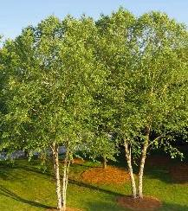
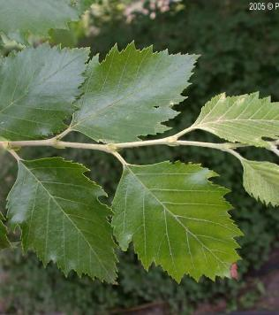
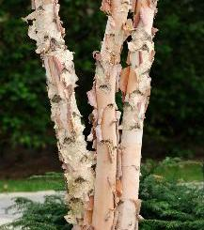
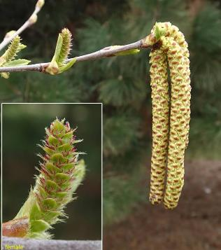
River birch
Large deciduous tree
Leaves are alternate
Peeling bark, can be single trunk or multiple trunks
Arrowhead-shaped leaf – “Arrowheads are found at the river”
Bright yellow foliage in the fall
Male and female catskins form in the spring (often before leaves)

Slide 4
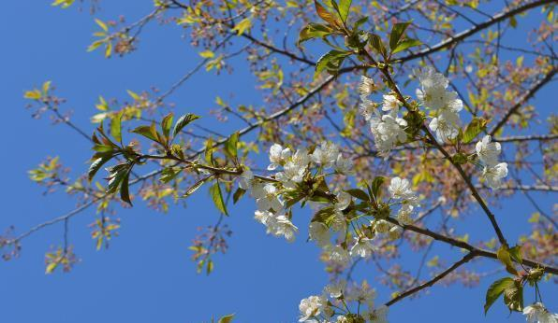
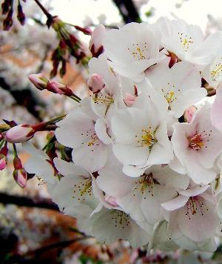
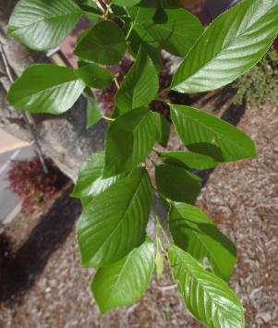
Japanese flowering cherry
Large, deciduous tree
Serrated leaves
Glands on petiole
Usually dark pointed buds
White – light pinkish flowers

Slide 5
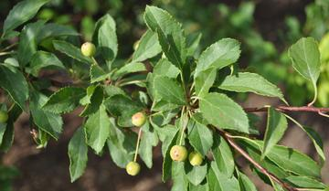
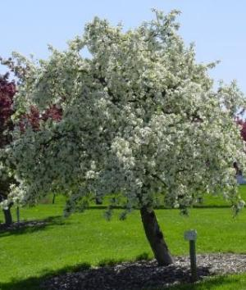
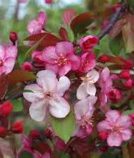
Flowering crabapple
Small deciduous tree
Spring flowering, flowers in shades of white to dark pink
Stubby stems
Simple ovate leaves with serrated margins. The leaves can be glossy and dark green.
Does produce fruit that are small and can be yellow, red or green

Slide 6
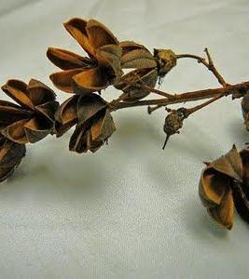
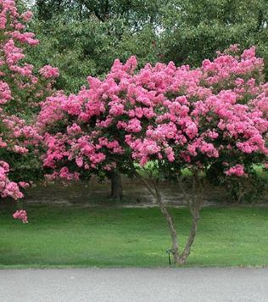
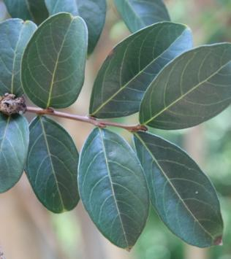
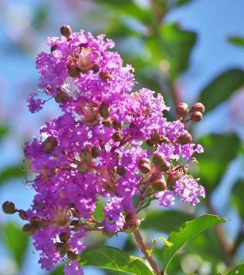
Crape myrtle
Opposite, alternate, or whorled leaves
Square stem on new growth
Smooth bark often exfoliating
Seed pods dark round / open seed pods remain on tree until new pods form in the spring

Slide 7
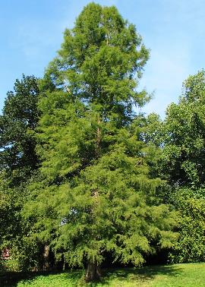
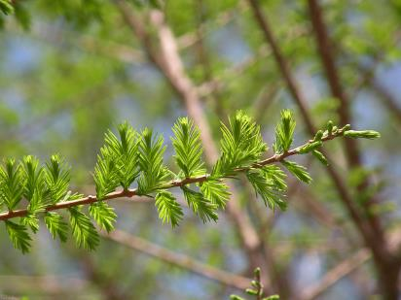
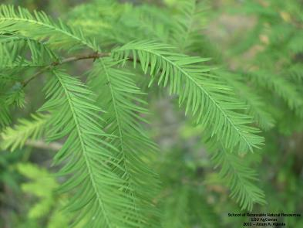
Bald cypress
Deciduous conifer
Lateral pronounced buds
Soft leaves that are “feather like”
Fibrous bark
New growth form on both branches as well as trunk

Slide 8
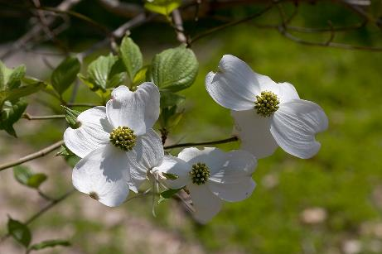
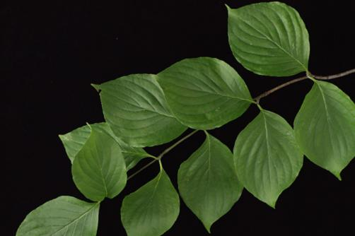
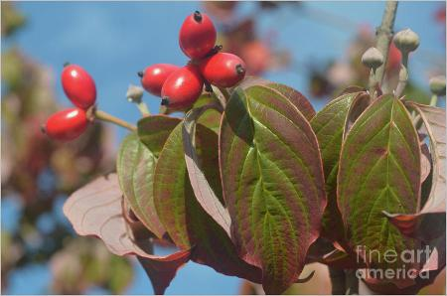
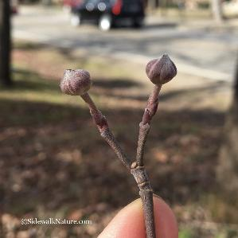
Flowering dogwood
Deciduous tree
Leaves opposite, simple, oval and up to 5 or 6 inches long.
Leaves have distinct veins
They are typically shiny green and smooth on the upper surface and paler on the lower surface
Stems create a V at the end
Red berries in the fall
Distinct flower buds

Slide 9
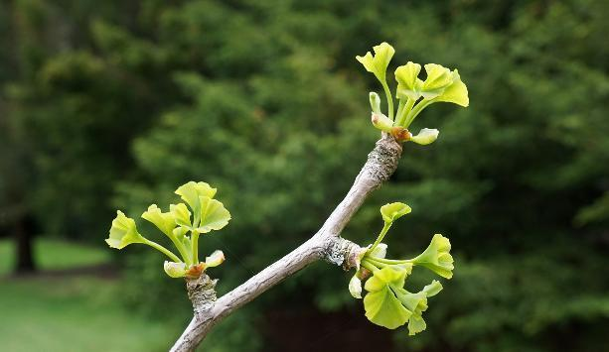
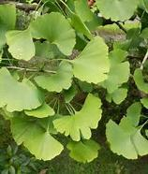
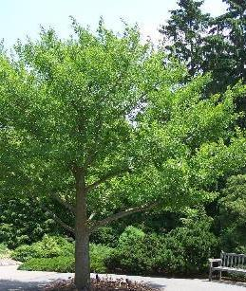
ginkgo
Alternate leaves
Deciduous tree
Accordion buds where new growth forms
Parallel veins with split-leaf
Leaf has a fan pattern

Slide 10
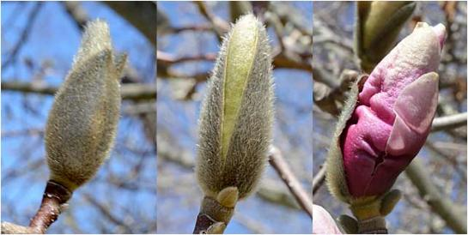
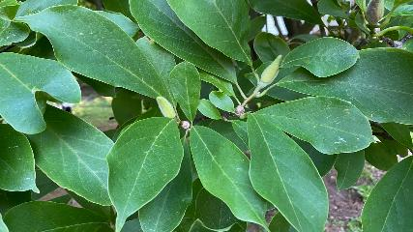
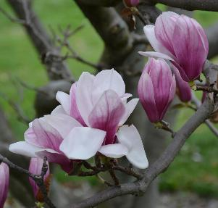
Saucer magnolia
Alternate leaves
Large pubescent (hairy) flower bud
Deciduous tree
Distinct lenticels
large, showy, cup-shaped flowers
Blooms before leaves form
Dark green, leathery, oval-shaped leaves

Slide 11
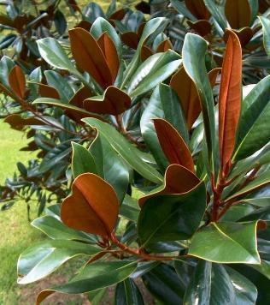
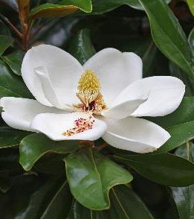
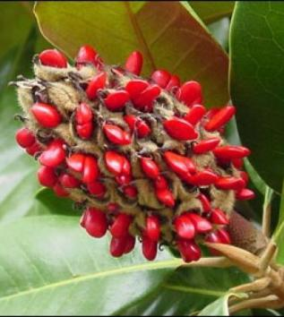
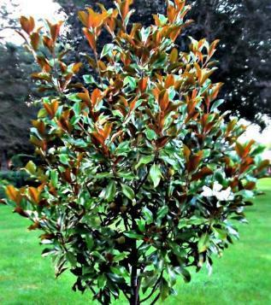
Southern magnolia
Alternate leaves that are evergreen
Large pubescent (hairy) buds
Leaves are large, leathery, dark green on top with a rusty brown fuzzy underside.
Flowers are big, cup-shaped, white, highly fragrant, with multiple petals
Fruit is cone-like, red and fuzzy when mature

Slide 12
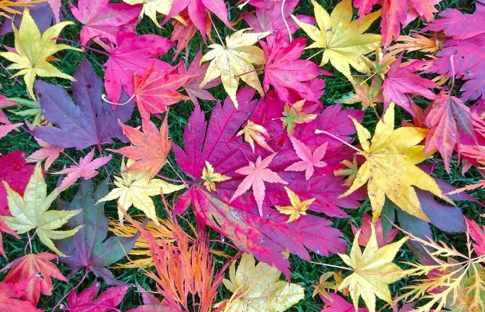
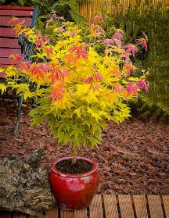
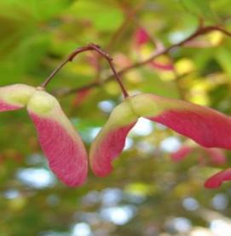
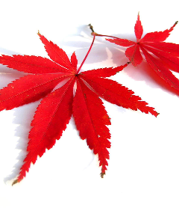
Japanese maple
Opposite leaf arrangement
Delicate (fine texture), deeply lobed, palmate leaves
can range from green to purple depending on the cultivar
Double terminal buds
rounded shaped tree and sometimes have multiple trunks

Slide 13
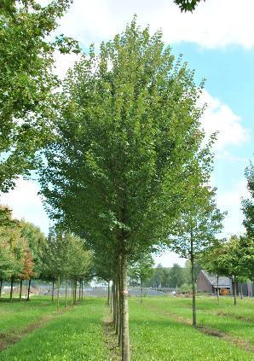
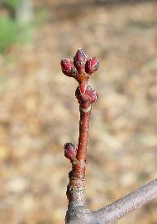
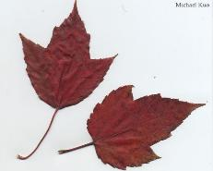
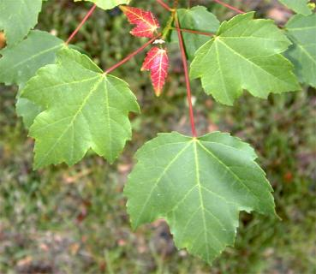
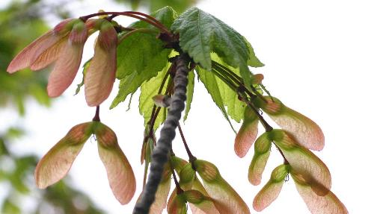
Red maple
Opposite, simple leaf with a red petiole (stem)
3 lobbed leaf - RED
Clusters of seeds that have wings
Leaves turn bright red in fall

Slide 14
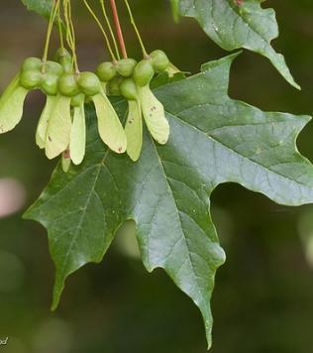
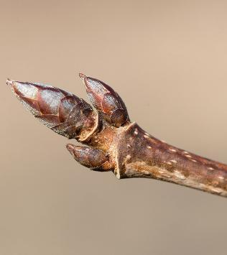
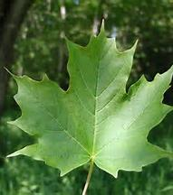
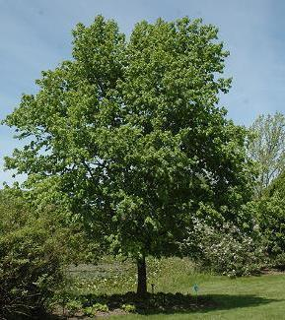
Sugar maple
Opposite simple leaf
5 lobbed leaf - S-U-G-A-R
Turn vibrant shades of red, orange, and yellow in the fall
Pencil point bud

Slide 15
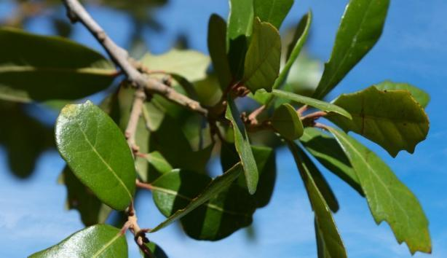
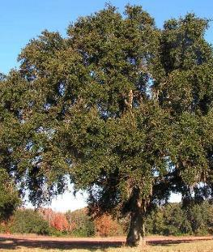
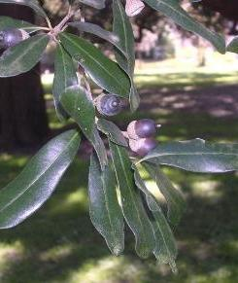
Live oak
Alternate simple leaf
Evergreen tree
Leaf is leathery and darker green on top and more gray on underside
Leaves are often cupped
Brown-yellowish midrib
Leaves are typically have smooth edges but will often see lightly scalloped or serrated leaves in younger trees

Slide 16
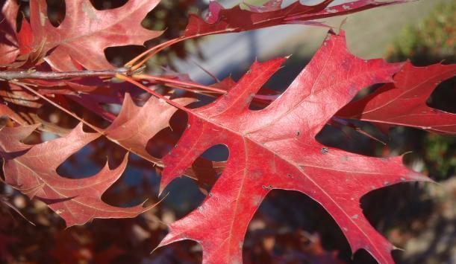
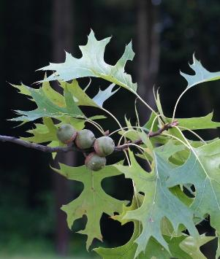
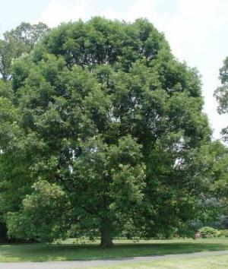
PIN oak
Deciduous Tree
Deeply pointed lobed leaves with a bristle at the tip of each leaf and each lobe
Leaves are dark green in summer, turning bright red in fall

Slide 17



White oak
rounded lobes on the leaves - with 5-9 rounded lobes on each side
Leaves are dark green on top, paler underneath.
Leaves are alternate
pale gray, scaly/blocky bark
Large acorns, up to 1 inch

Slide 18




Eastern white pine
5 needles - W-H-I-T-E
soft, bluish-green needles
Often with white stripe
Smooth bark
slender cylindrical cones, sometimes has white tips

Slide 19




Yellow (tuliptree) poplar
The leaves are alternate with a distinctive tuliplike (Cat face) shape leaf
Showy, goblet-shaped, and orange-yellow-green in color
Duck bill buds

Slide 20




Eastern redbud
Small deciduous tree
Heart-shaped, alternate leaf
Rick-rack (zig-zag) stem pattern
Reddish purple buds to pink flowers
Flowers bloom directly on bare branches before the leaves emerge
Produces flat, bean-like seed pods that mature to brown

Slide 21




Weeping willow
Deciduous tree
Long, drooping branches that sweep towards the ground, giving it a "weeping" look
Alternate, simple leaf
Long, narrow, finely serrated, with a pointed tip
The underside of leaf has a light green to white/silverish tint
Does flower, but flowers are small, inconspicuous tuffs

Slide 22


Now let’s compare
Flowering Cherry(Yoshino)
Flowering Crabapple
Simple, with serrated edges
Often more rounded in shape and appear in clusters
New growth may have a reddish tint
Flowers come in a wider range of colors (white, pink, red, magenta)
Bark is typically rougher and less ornamental than Yoshino cherry bark
Simple, ovate leaves with finely serrated edges
Pale pink to white flowers, fragrant, and typically 5-petaled
Smooth bark with horizontal lenticels (marks/gashes)

Slide 23



Now let’s compare

Slide 24




Now let’s compare
Red Maple
Sugar Maple
Japanese Maple
3 lobes, serrated edges
The underside of the leaves is silvery or whitish
Bright red buds and twigs
Larger leaf with 5 lobes
Lobes are rounded or smooth-edged, without serrations.
Underside is pale green.
Stems are white or have a slight reddish tint
deeply lobed with 5–9 lobes.
Edges are finely serrated
Color varies widely
Ornamental appearance due to unique leaf shapes and colors

Slide 25



Now let’s compare
Live Oak
Pin Oak
White Oak
Evergreen, thick, leathery, Dark green on top with a paler, slightly fuzzy underside
Oblong or oval with smooth, slightly wavy edges
Deciduous, deeply lobed with 5–7 pointed lobes
Glossy green in summer, turning bronze or red in fall
Deciduous, with 7–9 rounded lobes (no points)
Pale green turning reddish-purple in fall

