Slide 1

Nursery/Landscape Plant Id tips
This is a free resource provided by Georgia Agricultural Education
Original creator: Melissa Riley, Central Region Horticulture Teacher

Slide 2
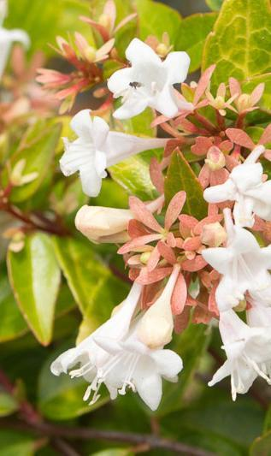
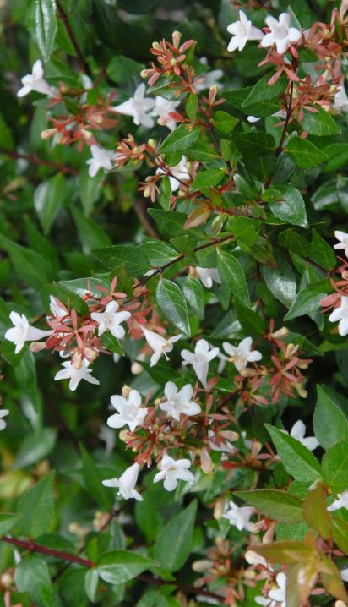
Glossy Abelia
Opposite leaves
Upside down raindrop or teardrop shape
Flowers trumpet shaped

Slide 3
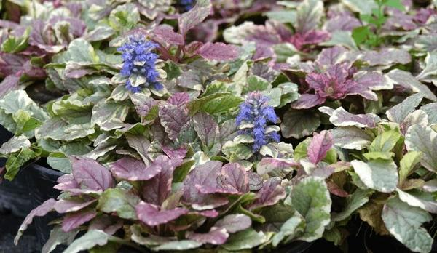
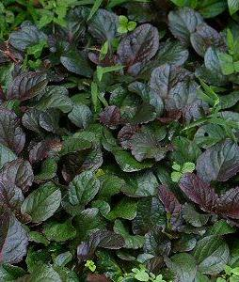
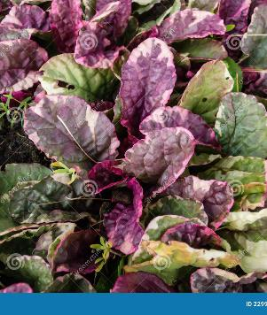
Ajuga (carpet bugle)
Ground cover, less than 1 foot tall
Leaves look like false dandelion
Tight dense growth-herbaceous
Flowers usually blue-purple
Leaves purple to bronze

Slide 4
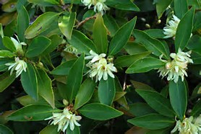
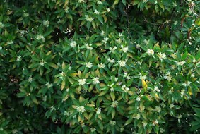
Japanese anisetree
Aromatic- alternate leaves
Evergreen tree/shrub
Arranged somewhat perpendicular to the stem
When crushed, leaves smell like black licorice

Slide 5
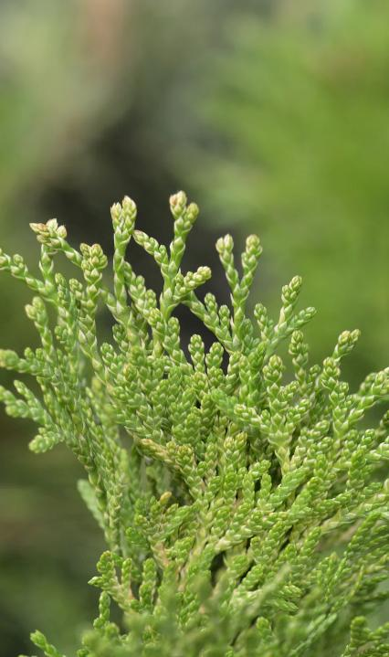
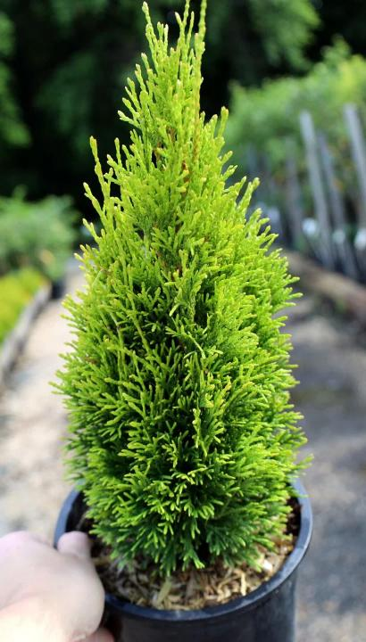
arborvitae
Grows 12-14 feet tall
deep and rich green color year-round,
foliage grows in flat sprays
close up, the needles appear covered in fine green scales.

Slide 6
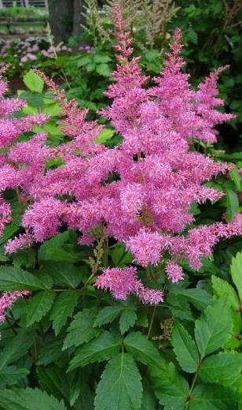
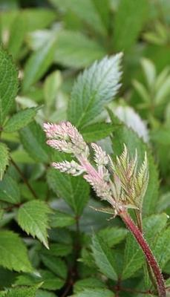
astible
Herbaceous perennial
Fern-like foliage
Flowers spike often remain

Slide 7
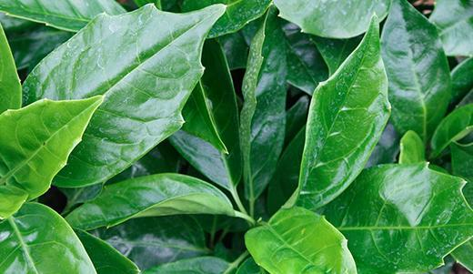
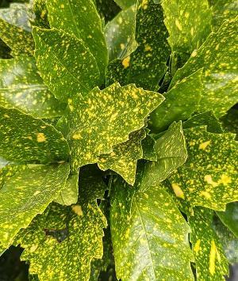
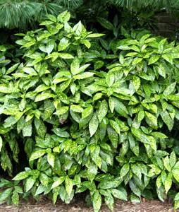
Japanese aucuba
Opposite evergreen leaf-
Leaves have a plastic or waxy texture
Can be green or variegated
Slightly serrated edges

Slide 8
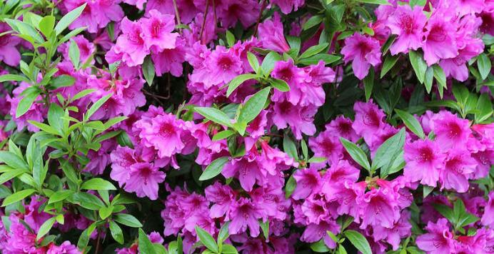
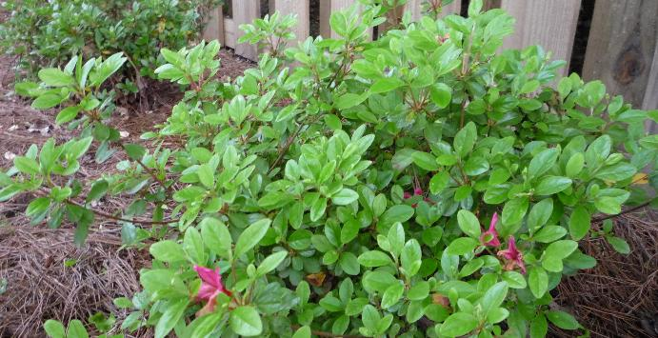
azalea
Evergreen with dull green leaves
Pubescent / leaves are fuzzy
Growth is always at the end of the stems, center of plant has no foliage
Flowers in many different colors
Flowers form in groups/clusters

Slide 9
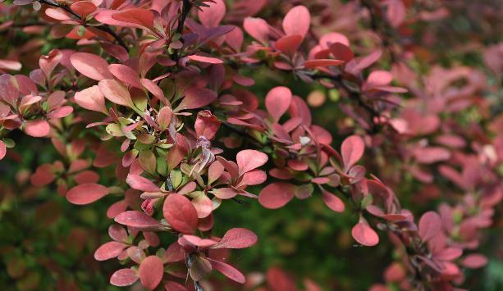
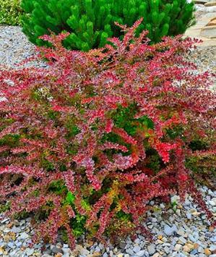
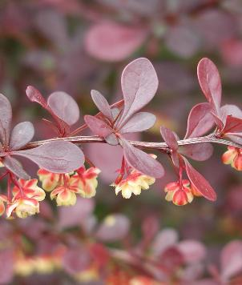
Japanese barberry
Alternate, deciduous leaves
Stem covered in thorns, very visible in the winter but hidden by leaves in spring and summer
Leaves can be maroon to green to yellow
Small flowers and berries

Slide 10
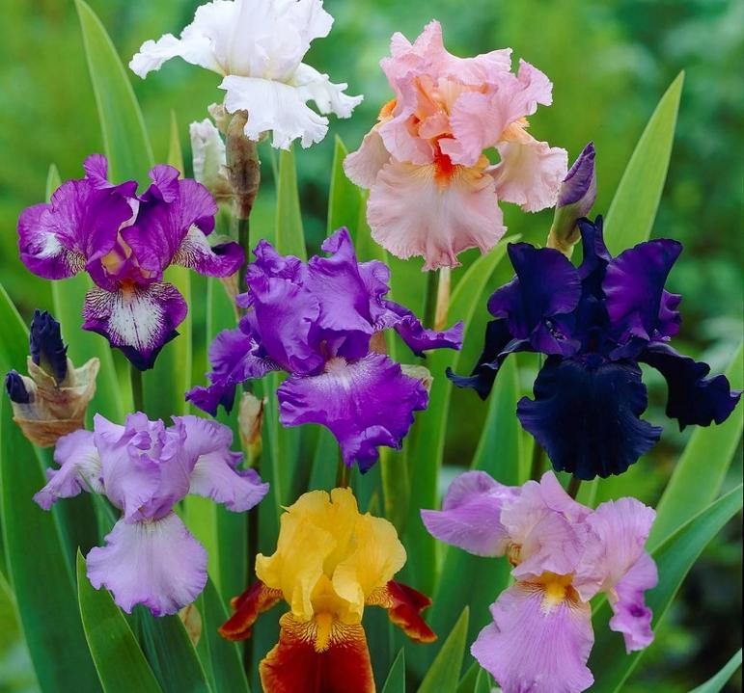
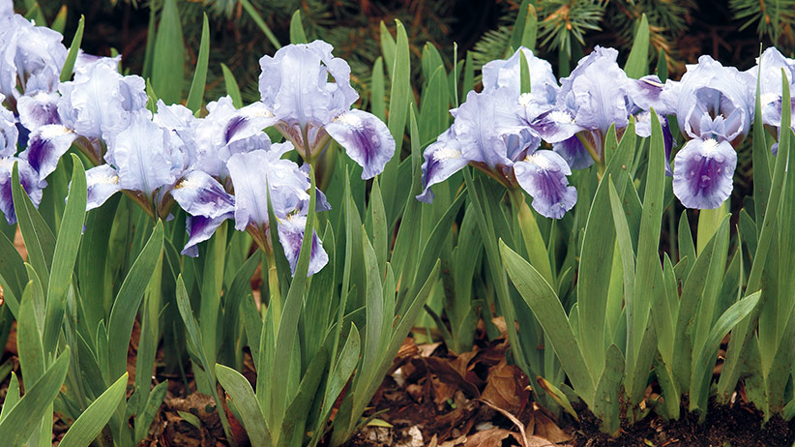
Bearded Iris
a perennial flower
large, showy blooms with three upright petals and three downward-facing petals and a fuzzy "beard" running down the middle
Flowers in many colors
sword-shaped leaves that overlap each other in a fan shape

Slide 11
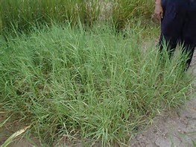
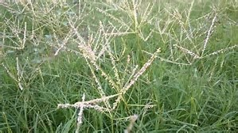
Bermudagrass hybrid
Warm season grass with runners
45 degree angle

Slide 12
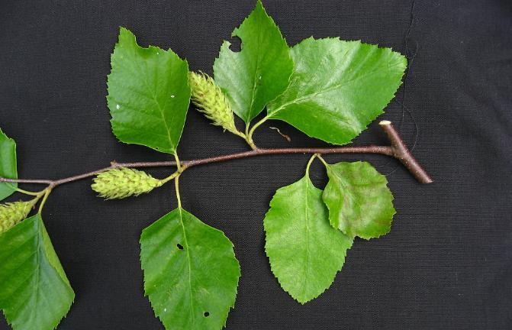
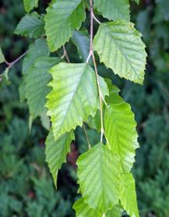
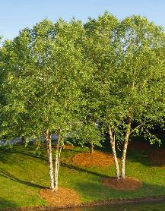
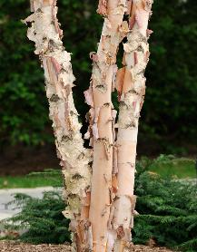
River birch
Large deciduous tree
Leaves are alternate
Peeling bark, can be single trunk or multiple trunks
Arrowhead-shaped leaf – “Arrowheads are found at the river”
Bright yellow foliage in the fall

Slide 13
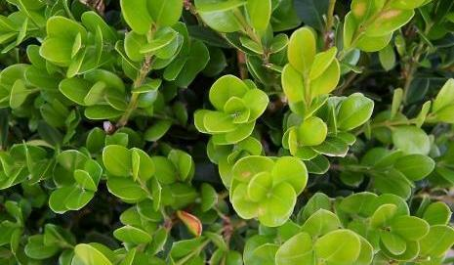
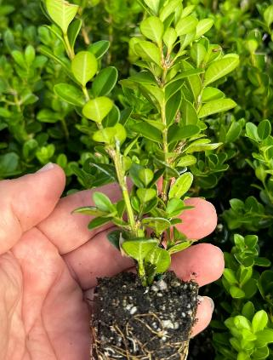
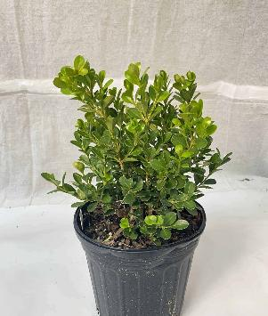
boxwood
Opposite leaves
Has a distinct (often unpleasant) smell
Often square with stem groove
The midrib on the bottom of the leaf is often white (most varieties)

Slide 14
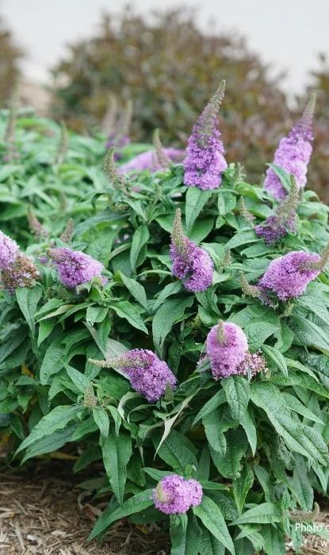
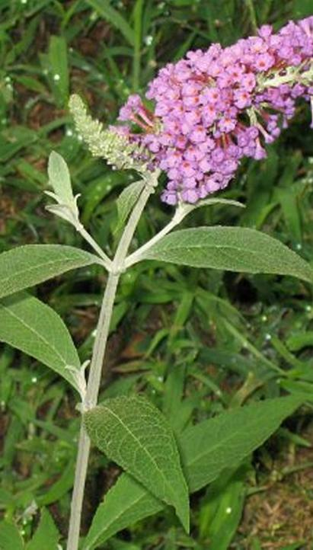
Butterfly bush
Opposite leaves
Deciduous plant
Underside of the leaf is white/greyish color
4-8 sided stem
Blooms in several colors
Large flower spike often remains on plant

Slide 15
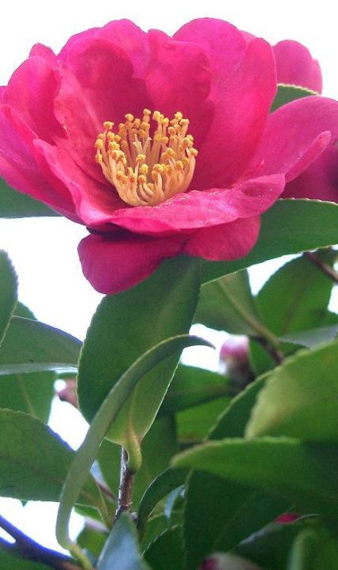
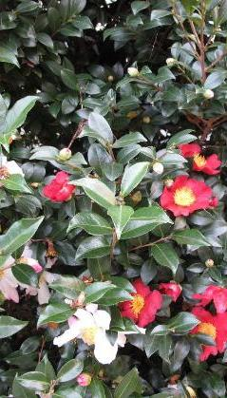
Sasanqua camellia
Smaller than Japonica – 6-14 feet tall
Serrated, dark green leaves, leaves are also alternate
Plastic, Waxy feeling leaves
Curved petiole around bud
Delicate flowers with exposed stamen as the flower opens

Slide 16
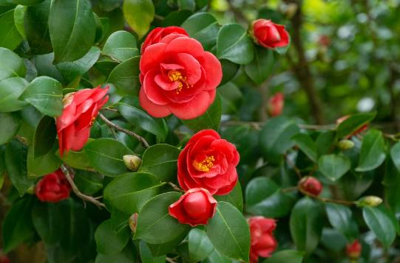
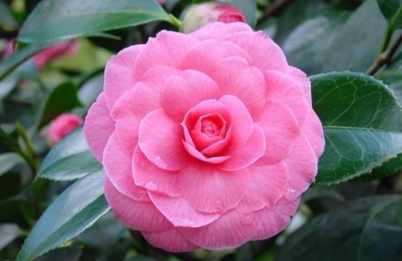
Camellia, japonica
Evergreen shrub, larger than sasanqua 6-25 feet tall
Serrated, dark green leaves, leaves are also alternate
Plastic, Waxy feeling leaves
Black glands(dots) on tips of serrations

Slide 17
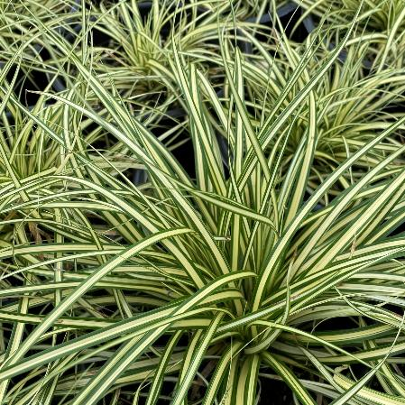
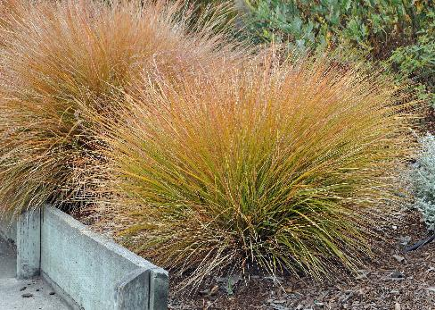
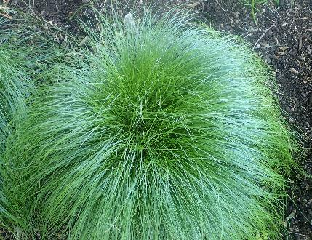
carex
Grass-like with narrow leaves, often forming clumps or tufts
In the sedge family so has a sharp triangular shaped stem edges
Often weeping leaves

Slide 18
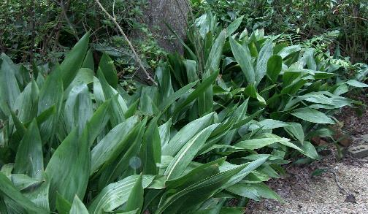
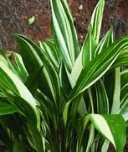
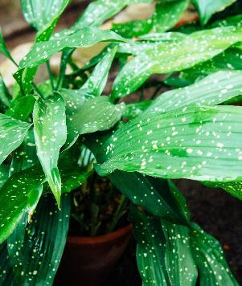
Cast iron plant
Evergreen shrub or clump
Parallel venation
Each leaf is on a single stem
Large, glossy leaves that can be solid green, speckled or variegated

Slide 19
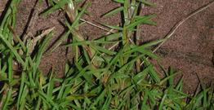
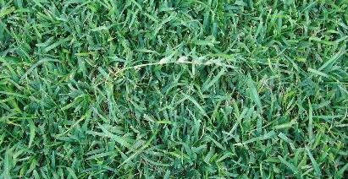
centipedegrass
Warm season grass
Wide flat blades
Alternate arrangement
white midrib/runners

Slide 20
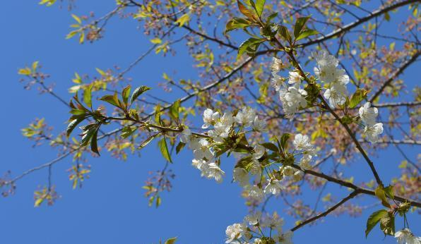
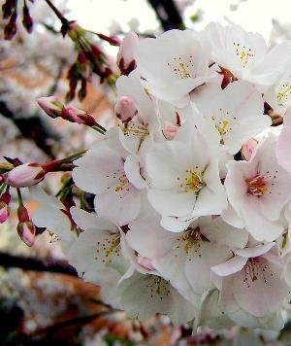
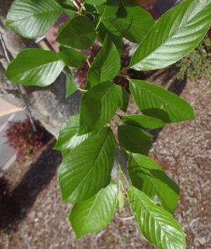
Japanese flowering cherry
Large, deciduous tree
Serrated leaves
Glands on petiole
Usually dark pointed buds
White – light pinkish flowers

Slide 21
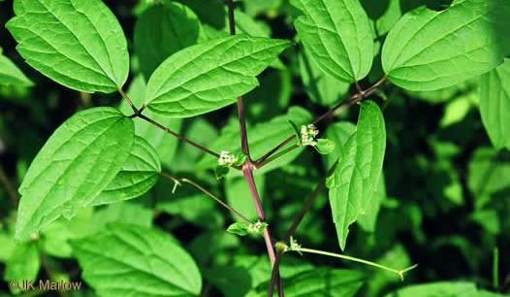
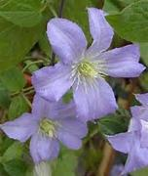
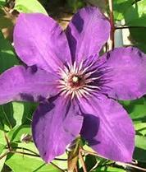
Clematis
Can be both and evergreen or deciduous vine
Terminal leaflets in 3’s
Usually staked on trellis or poles
Blooms in a variety of colors
Very fragile, small stems

Slide 22


Japanese cleyera
Alternate leaf arrangement
Evergreen shrub
Red petiole
Leaves form in a whorled patter
Glossy leaves

Slide 23



columbine
Shade perennial
3-part serrated leaf
Leaves are slightly lobed
Flowers in different colors
Five-petaled flowers that have long backward-extending spurs

Slide 24



Coral bells
low-growing, clump-forming perennial plant
Heart shaped or triangle shaped leaf
colorful foliage in shades of green, purple, or copper
small, bell-shaped flowers on slender stems rising above the leaves
Leaf pattern varies
Veins are often prominent and contrasting with the leaf color

Slide 25



Flowering crabapple
Small deciduous tree
Spring flowering, flowers in shades of white to dark pink
Stubby stems
Simple ovate leaves with serrated margins. The leaves can be glossy and dark green.
Does produce fruit that are small and can be yellow, red or green

Slide 26




Crape myrtle
Opposite, alternate, or whorled leaves
Square stem on new growth
Smooth bark often exfoliating
Seed pods dark round / open seed pods remain on tree until new pods form in the spring

Slide 27


Cryptomeria
Evergreen conifer tree
Soft, needle like foliage
Foliage spirally (circular) arrangement on stem
Cones form only on ends of branches

Slide 28



Bald cypress
Deciduous conifer
Lateral pronounced buds
Soft leaves that are “feather like”
Fibrous bark
New growth form on both branches as well as trunk

Slide 29



daylily
Herbaceous perennial
Leaves cupped with a pronounced center vein
Sometimes, dead flower spike remains

Slide 30



distylium
Compact, evergreen shrub
Small flowers form at the base of the leaves, typically red
Oval, alternate foliage that is light to dark green
Upright to weeping growth pattern

Slide 31




Flowering dogwood
Deciduous tree
Leaves opposite, simple, oval and up to 5 or 6 inches long.
Leaves have distinct veins
They are typically shiny green and smooth on the upper surface and paler on the lower surface
Stems create a V at the end
Red berries in the fall
Distinct flower buds

Slide 32



Winged euonymus
“Burning Bush” another name because of red fall color
Deciduous shrub
Corky wings on the bark
Opposite leaves

Slide 33


golden mop threadleaf False cypress
Evergreen
Flat not sharp like juniper
White X on back unlike arborvitae
Yellow (golden) in color

Slide 34


fescue
Cool season grass
Clumps no runners
Serrated backward
Collars around stem

Slide 35



Border forsythia
Opposite buds
Bark is speckled
Hollow stem
Bottom half of leaf smooth, top serrated
Yellow flowers form before leaves

Slide 36



Fountain grass
Tender perennial
ornamental grass
Leaves have a purple tint
Long linear leaves
Clumps with plume flowers

Slide 37



Cape jasmine gardenia
Opposite leaves
Evergreen
Ribbed veins on the backside of leaves
Flower buds appear rolled with long protective leaves protecting the bud

Slide 38



ginkgo
Alternate leaves
Deciduous tree
Accordion buds where new growth forms
Parallel veins with split-leaf
Leaf has a fan pattern

Slide 39



Indian hawthorn
Alternate leaves that are slightly serrated
Evergreen rounded shrub
Sometimes purple margins
Often looks whorled at ends
Flowers can be white or pink, with dark berries in the fall

Slide 40


Carissa holly
Compact, evergreen shrub
Alternate leaves
Leaves are hard and glossy
leaf curved up
Distinct line around outside of leaf

Slide 41


Chinese holly
Broadleaf evergreen shrub
Alternate leaves
7 spines/points on leaves
  C-H-I-N-E-S-E
Dark green, glossy leaf

Slide 42


Compacta holly
Evergreen shrub
Alternate leaves
Leaves are rounded, older leaves are also slightly toothed at the ends
Dark glands on the underside of the leaf
Candleabra-shaped appearance

Slide 43


Dwarf burford holly
Evergreen shrub
Alternate leaves
Leaf cups down or is bent over
Leaves narrow to point at the end, rounded at the bottom

Slide 44



Dwarf yaupon holly
Evergreen shrub
Football-shaped leaves, slightly scalloped on edges
Purple to gray stems
New growth has purple tint

Slide 45



Helleri holly
Evergreen shrub
Dark glands on back of the leaf
Rounded shape but stems cross over each other / Horizontal type growth
Obovate, evergreen leaves - 0.5 inches long and have a few crenate teeth at the tips of the leaves

Slide 46



Sky pencil holly
Slender-vertical type growth
Dark glands on back of leaf
Leaves also grow upright
Leaves have slightly scalloped edges

Slide 47



Savannah holly
Type of foster holly / Large shrub often pruned into a tree
Large red fruit/abundant fruit producer
Spiny edges on the leaves
Leaves are not as thick as other holly varieties
Leaves are larger than other hollies, 1-3 inches in length

Slide 48

Weeping yaupon holly
Evergreen shrub
weeping / drooping branches that cascade downward from the trunk
Football-shaped leaves with slightly scalloped edges
Purple to gray stems

Slide 49



hosta
Perennial-shade plant
Parallel veins
Many varieties with different shades of green, blue, gold, and white and leaf shapes
New growth emerges as spikes and uncurls as it grows
Trumpet-shaped flowers form on a spike, usually bloom white or purple

Slide 50


Oakleaf hydrangea
Deciduous shrub
Opposite leaves
Leaves look similar to oak leaf
Large, dark green leaves with silvery undersides and 3–7 lobes
Orangey tint to stem and bark
Older bark peels in thin flakes
Flowers form in clusters/cones of white to pink.

Slide 51


Bigleaf hydrangea
Deciduous shrub
Opposite leaves
Leaves are large, often serrated
Very pronounced veins and a scale-like appearance to leaves
Big, showy flower heads in white, pink, purple or blue

Slide 52


English ivy
Evergreen
Vine or Trailing Groundcover
Woody stems on older growth
Three-lobed/starlike shaped leaf
Can be variegated

Slide 53



Confederate jasmine
Evergreen vine
Star flowers
Leaves opposite and have a thick, fleshy texture
Woody stems, dark brown to reddish in color
Produce long, narrow seed pods

Slide 54


Blue rug juniper
Evergreen groundcover
Soft needles, not spikey like shore
Fine, scale-like needles with a bluish-silver color that can turn purple in cold weather
Needles have an upright growth pattern, but the plant does not get over 1 foot tall

Slide 55


Shore juniper
Evergreen groundcover
blue-green, awl-shaped, prickly needles / not flat like blue rug
White tips to the leaves

Slide 56



Andorra juniper
Evergreen groundcover
fine, soft, gray-green foliage that often takes on a plum-purple hue in the winter months
Out and up growth pattern
about 18” tall

Slide 57



Lenten rose
Shade perennial
Soft stems often bend or fall over
Leaves palmate with 5-6 lobes
Flowers have overlapping petals.
Flowers can range from white to pink or light purple, often with spots inside and exposed stamen

Slide 58


lantana
Summer sun perennial – can be both evergreen and deciduous depending on variety.
Fragrant shrub or groundcover
Scratchy leaves (can cause an allergic reaction)
Leaves are oval shaped and opposite
Woody stems
Vibrant, clustered blooms that can be multiple colors within a single cluster

Slide 59



Ligustrum, sunshine
Compact, evergreen shrub with vibrant, golden-yellow foliage
Does not produce flowers or seeds
Bright, glossy, golden yellow leaves
Leaves have wavy edges
Stem on new growth can have reddish tint

Slide 60




liriope
Herbaceous
Clump/grass-like – can be dark green or variegated
Flat leaf, does not cup like daylily
Upright flower spikes that can be purple, lavender, pink, or white depending on the variety
Forms berries that can leave a spike
Leaf has parallel veins
grows 12-18" tall

Slide 61



loropetalum
Evergreen shrub
Alternate leaves
Leaf veins pronounced
Rough pubescent (hairy) texture
Leaves purple to green in color
Flowers look fringed and are pink/white
Flowers form at the end of the stem or base of the leaf

Slide 62



Saucer magnolia
Alternate leaves
Large pubescent (hairy) flower bud
Deciduous tree
Distinct lenticels
large, showy, cup-shaped flowers
Blooms before leaves form
Dark green, leathery, oval-shaped leaves

Slide 63




Southern magnolia
Alternate leaves that are evergreen
Large pubescent (hairy) buds
Leaves are large, leathery, dark green on top with a rusty brown fuzzy underside.
Flowers are big, cup-shaped, white, highly fragrant, with multiple petals
Fruit is cone-like, red and fuzzy when mature

Slide 64




Leatherleaf mahonia
Leaves are alternate and form what look like wings
distinctive, holly-like, pinnately compound leaves that have sharp teeth along the edges
Yellow flowers with a blue fruit spike

Slide 65




Japanese maple
Opposite leaf arrangement
Delicate (fine texture), deeply lobed, palmate leaves
can range from green to purple depending on the cultivar
Double terminal buds
rounded shaped tree and sometimes have multiple trunks

Slide 66





Red maple
Opposite, simple leaf with a red petiole (stem)
3 lobbed leaf - RED
Clusters of seeds that have wings
Leaves turn bright red in fall

Slide 67




Sugar maple
Opposite simple leaf
5 lobbed leaf - S-U-G-A-R
Turn vibrant shades of red, orange, and yellow in the fall
Pencil point bud

Slide 68



miscanthus
Tall, clump-forming ornamental grass
Typically grows to 3-7' tall
Long, slender, arching leaves featuring a silvery midrib
Feathery, plume-like flower panicles that can be pink to red in color
Also known as maiden grass or Chinese silver grass

Slide 69




Mondo grass
Grass-like, narrow, dark green leaves that form arching clumps
Shorter stems that liriope
Parallel veins
Blue berries/fruit
Small, bell-shaped, pale lilac to white flowers
8-12” tall

Slide 70


Dwarf nandina
Leaves form in clusters of 3 at the end of the stem
Usually less than 30”
Shorter internode than Nandina
Red fall color
Bamboo-like stems

Slide 71




nandina
Alternate bipinnate to tri-pinnate leaves
3 leaves at the end of the stem
grows to 4-8' tall
Longer internodes than dwarf
Often leggy with cane-like stems resembling bamboo
small white flowers in spring followed by bright red berries that persist through winter

Slide 72



Live oak
Alternate simple leaf
Evergreen tree
Leaf is leathery and darker green on top and more gray on underside
Leaves are often cupped
Brown-yellowish midrib
Leaves are typically have smooth edges but will often see lightly scalloped or serrated leaves in younger trees

Slide 73



PIN oak
Deciduous Tree
Deeply lobed leaves with pointed tips
Leaves are dark green in summer, turning bright red in fall

Slide 74



White oak
rounded lobes on the leaves - with 5-9 rounded lobes on each side
Leaves are dark green on top, paler underneath.
Leaves are alternate
pale gray, scaly/blocky bark
Large acorns, up to 1 inch

Slide 75



Tea olive osmanthus
Evergreen shrub
Opposite, simple leaf
Glossy, oval-shaped, leathery green leaves
Distinct vein on the underside of leaf
Leaf margins may be smooth or finely toothed
Fragrant white flower

Slide 76



pachysandra
Evergreen groundcover
Whorled leaflets
Scalloped or Serrated at the ends of leaf
Grows 8-12" high
Flowers are small, white, and in 1-2 inch spikes

Slide 77




pieris
Alternate simple leaves
Evergreen
Slightly Serrated
New growth often reddish/whorled
Mass of bell shaped flowers
Brown to black “knots” at the nodes
White mid-rib

Slide 78


Mugo pine
Needles in pairs
Needs up to 3” long
Typically low-growing shrub pine

Slide 79




Eastern white pine
5 needles - W-H-I-T-E
soft, bluish-green needles
Often with white stripe
Smooth bark
slender cylindrical cones, sometimes has white tips

Slide 80




Japanese pittosporum
Rounded, evergreen shrub
Alternate simple leaf
Leaves are leathery and glossy, with downward rolled margins
Can be solid green or variegated
Distinct midrib

Slide 81





plumbago
evergreen, sprawling shrub - slender, climbing stems
clusters of delicate, pale blue, trumpet-shaped flowers
glossy green, spoon-shaped leaves with a distinctive ear-shaped base
Leaves grow in clusters with long spacing between nodes
Flower buds appear to have small hairs or spikes

Slide 82




Yellow (tuliptree) poplar
The leaves are alternate with a distinctive tuliplike (Cat face) shape leaf
Showy, goblet-shaped, and orange-yellow-green in color
Duck bill buds

Slide 83




Variegated privet hedge
evergreen or semi-evergreen shrub
Opposite leaves
oblong oval (football) shaped leaves
Sporadic dense (thick) growth pattern
Always Variegated
Leaves are green in center with white margins, occasionally have dark green spots randomly on the outside edge of the leaf

Slide 84




Flowering quince
Alternate leaves
Glossy, dark green, oval to oblong leaves with serrated edges
Large stipules (appear as small leaves at the base of larger leaves)
Thorn and thornless varieties – thorns are often hidden under leaves
Elbows lack of terminal bud
showy, vibrant red, pink, or white flowers that bloom early in spring before the leaves fully appear
Fruit 2” in diameter

Slide 85




Eastern redbud
Small deciduous tree
Heart-shaped, alternate leaf
Rick-rack (zig-zag) stem pattern
Reddish purple buds to pink flowers
Flowers bloom directly on bare branches before the leaves emerge
Produces flat, bean-like seed pods that mature to brown

Slide 86




rhododendron
Evergreen shrub
Alternate, simple leaf
Oblong leaves almost in whorls
Dark green almost glossy above, paler below
Leaves are long and leathery
New growth grows more upright where older leaves cup downward
Gray-brown bark that develops fine scales with age
Flower buds are cone or scale like in appearance

Slide 87




Landscape rose
Alternate, compound leaf
Usually with thorns on the stem
Serrated leaves form in leaflets of typically 5-7
Flower buds have long sepals that overlap before opening
New growth and stems are often red

Slide 88



Rosemary
Woody perennial herb
thick, leathery leaves resemble needles,
Needles have a dark green upper surface and powdery white, hairy underside
Stems, especially on new growth, are a grey color
Upright growth pattern
Very fragrant
Can flower - range from pale blue to purple
Can get 4-6 feet tall

Slide 89



Sago palm
Pseudo whorl
Thick, shaggy - unbranched trunk
Glossy, arching, fern-like leaves
Pointed leaflets that curl slightly at the edges

Slide 90




salvia
Herbaceous perennial
Hardy
Medium green to gray-green leaves with a slightly wrinkled texture
Leaves are opposite, are rough/ scratchy, and attached directly to the stem with little to no petiole
Tall flower spike- Purple is most common but new varieties can be found with white and pinkish flowers

Slide 91




Shasta daisy
perennial flowering plant
large, daisy-like blooms – only blooms white w yellow center
Leaves are dark green, slightly fleshy feeling, oblong in shape, and coarsely toothed along the edges
Leaves are typically large at the base of the plant and become smaller as they progress up the flowering stems

Slide 92


sedum
Small growing perennial
Come in a variety of colors and sizes
Most varieties are low growing and spreading
Have rounded succulent leaves
Leaves are opposite
Most flowers but flowers also range in size and color

Slide 93




spirea
compact, deciduous shrub
Alternate simple leaf
Lance shaped serrated / sharply toothed leaf
Pronounced midrib on underside of leaf
Red - Pinkish - purple flowers
Leaves emerges with pinkish-purple tints in spring and turns purplish-bronze in fall

Slide 94




Snowball viburnum
Deciduous, large shrub
Opposite, simple leaves with smooth or lightly toothed edges
Branches are opposite and grow at a 45 degree angle – “forming a V for Viburnum”
large, showy, snowball-like clusters of white flowers

Slide 95



Vinca (periwinkle)
low-growing, trailing evergreen vine
opposite leaves that can be solid green or variegated
Smooth margins and often features a white midrib
Bluish/purple or white 5 petal flowers

Slide 96




Bayberry wax myrtle
Small, evergreen shrub or tree
Flat, toothed, and fragrant when crushed
Leaves are slightly twisted
Small round drupe purplish attract directly to the branch under the leaves
Spikes often remain on the stem where fruit has been

Slide 97




Weeping willow
Deciduous tree
Long, drooping branches that sweep towards the ground, giving it a "weeping" look
Alternate, simple leaf
Long, narrow, finely serrated, with a pointed tip
The underside of leaf has a light green to white/silverish tint
Does flower, but flowers are small, inconspicuous tuffs

Slide 98





wintercreeper
evergreen to semi-evergreen mounding vine
Opposite, serrated leaves
Often roots form at nodes
Can be multiple colors
Wooden stem, older growth bark like appearance

Slide 99




Plum yew
Evergreen shrub
Can be upright or spreading
Linear leaves arranged in 2 planes
  V-shaped leaf pattern on a branch
2 gray bands beneath the leaf

Slide 100




Yucca (adams needle)
Leaf sword-like
Dark green and variegated varieties
Typically has threaded-like needle at the end of the stem
Filament peeling – looks like hairs
White flower spike – flowers are bell-shaped

Slide 101

Emerald zoysia
Leaves typically
80-90 degree angle
Smaller than centipede
Usually smooth to touch

